Slide 1
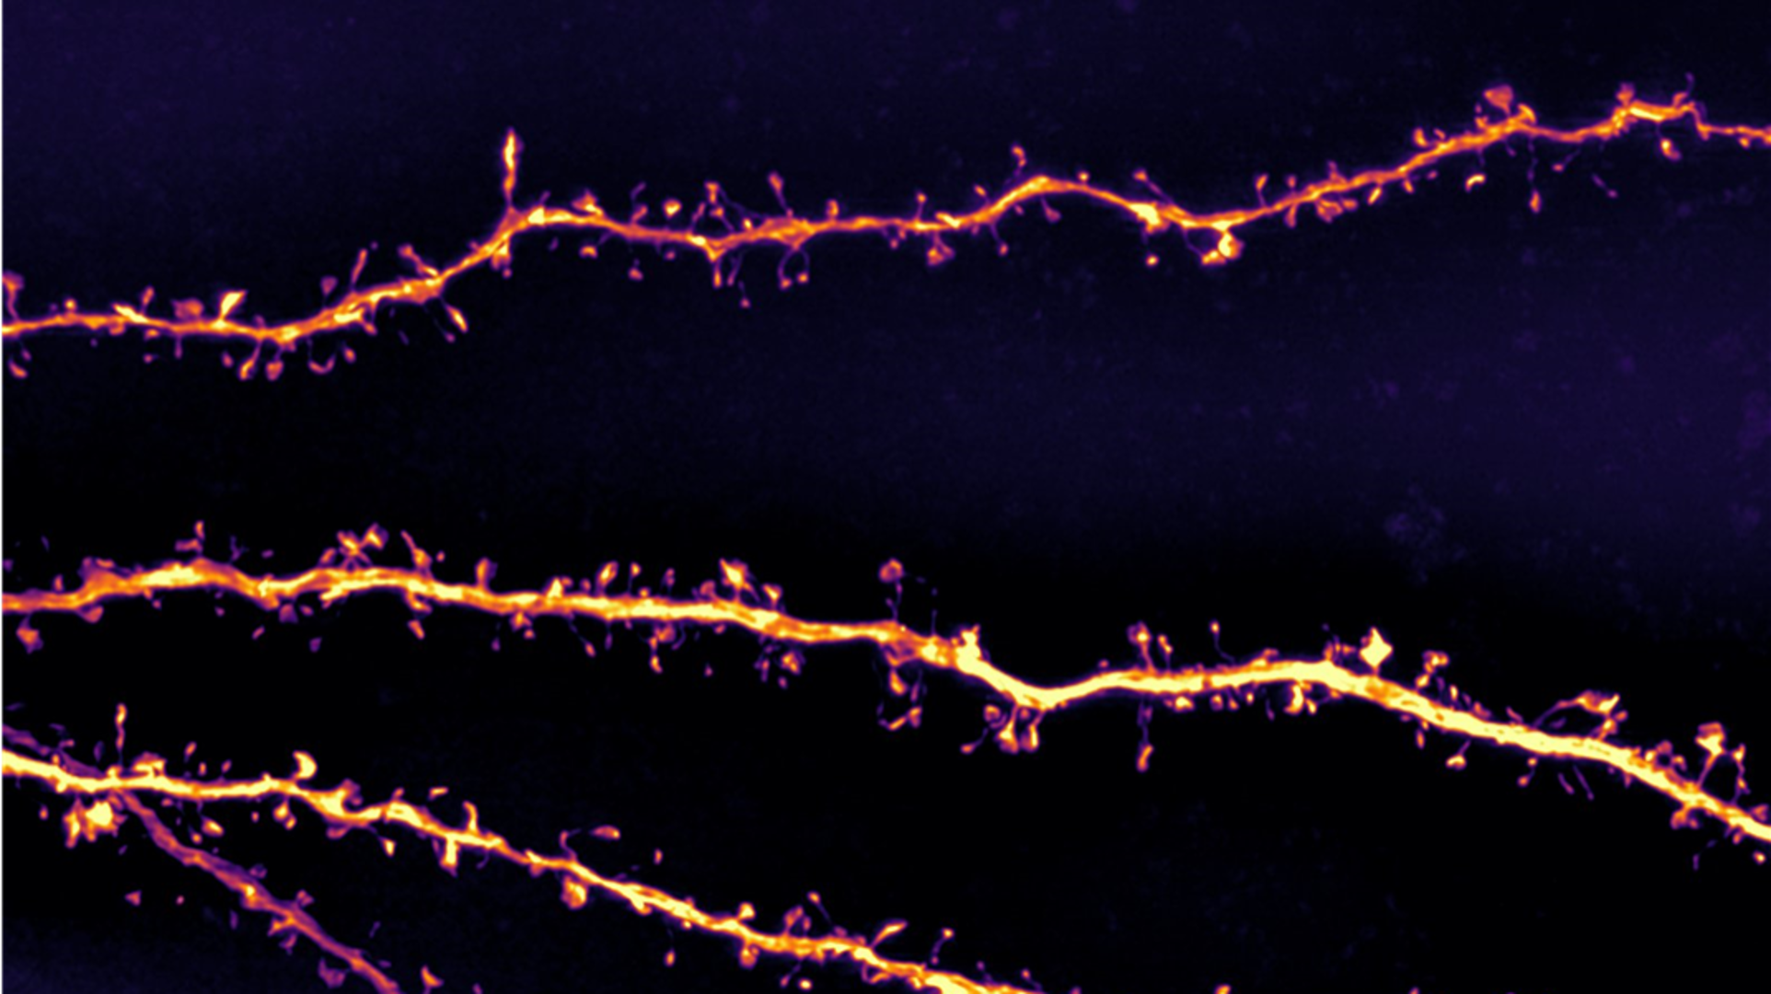
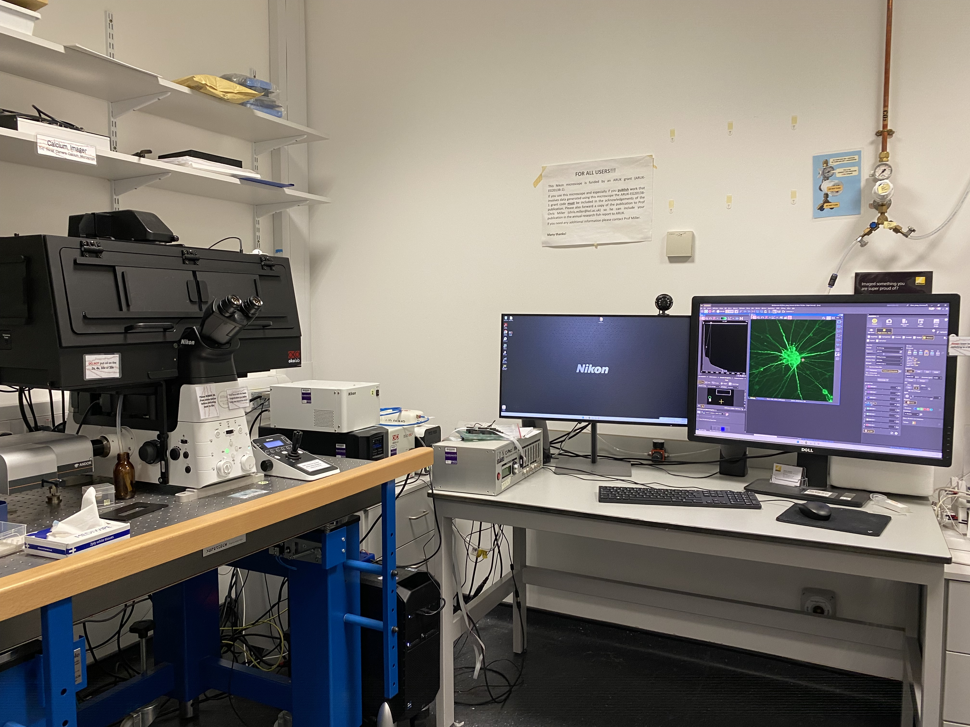
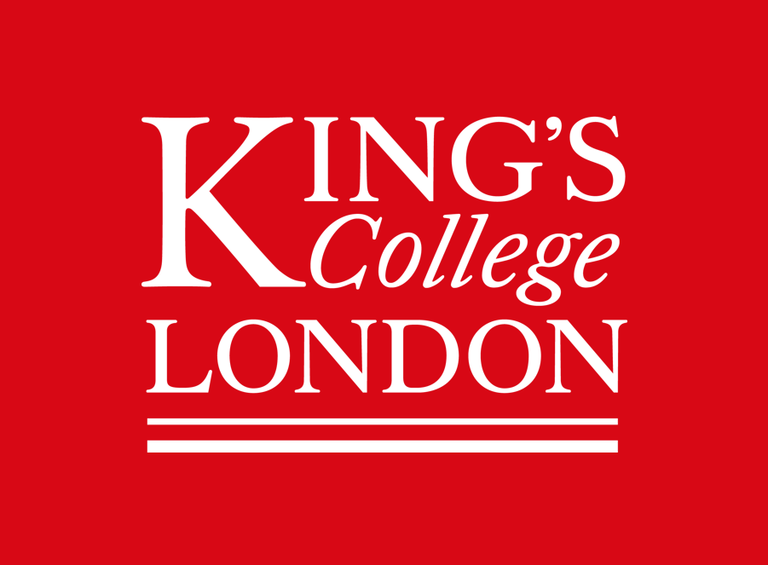

Nikon Ti2 – 3 Camera Calcium Microscope

Slide 2
STEP BY STEP INSTRUCTIONS
STEP 1
System ON
You can follow the 3 Cam Setup Detailed Demo video here:
URL: https://youtu.be/a1q3U2Pknc0
Or go on YouTube and search " 3 Cam Setup Detailed Demo "

Slide 3
STEP BY STEP INSTRUCTIONS
STEP 2
Set-up and Focus
Continue to follow the 3 Cam Setup Detailed Demo video:
URL: https://youtu.be/a1q3U2Pknc0
Or go on YouTube and search " 3 Cam Setup Detailed Demo "
ALWAYS lower the lenses to the very bottom!!!!
Before inserting the holder and clicking on another lens.

Slide 4
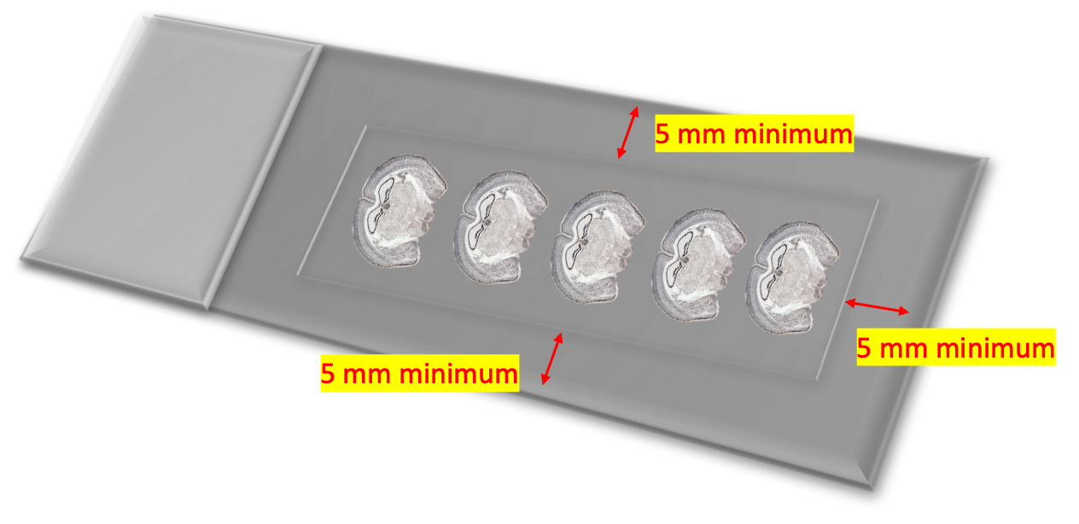
Sample
Clean and load your sample, coverslip side always face towards the lens, the labelling area preferably towards the right - hand side, push it into a corner and clip it down.
Make sure to mount your sample 5mm away from the edge of the slide! You cannot image too close to the edge of the slide.
Only move the joystick while looking down the eyepiece and you can see your sample clearly in FOCUS!

Slide 5
STEP BY STEP INSTRUCTIONS
STEP 3
See Your Sample On PC Screen

Slide 6
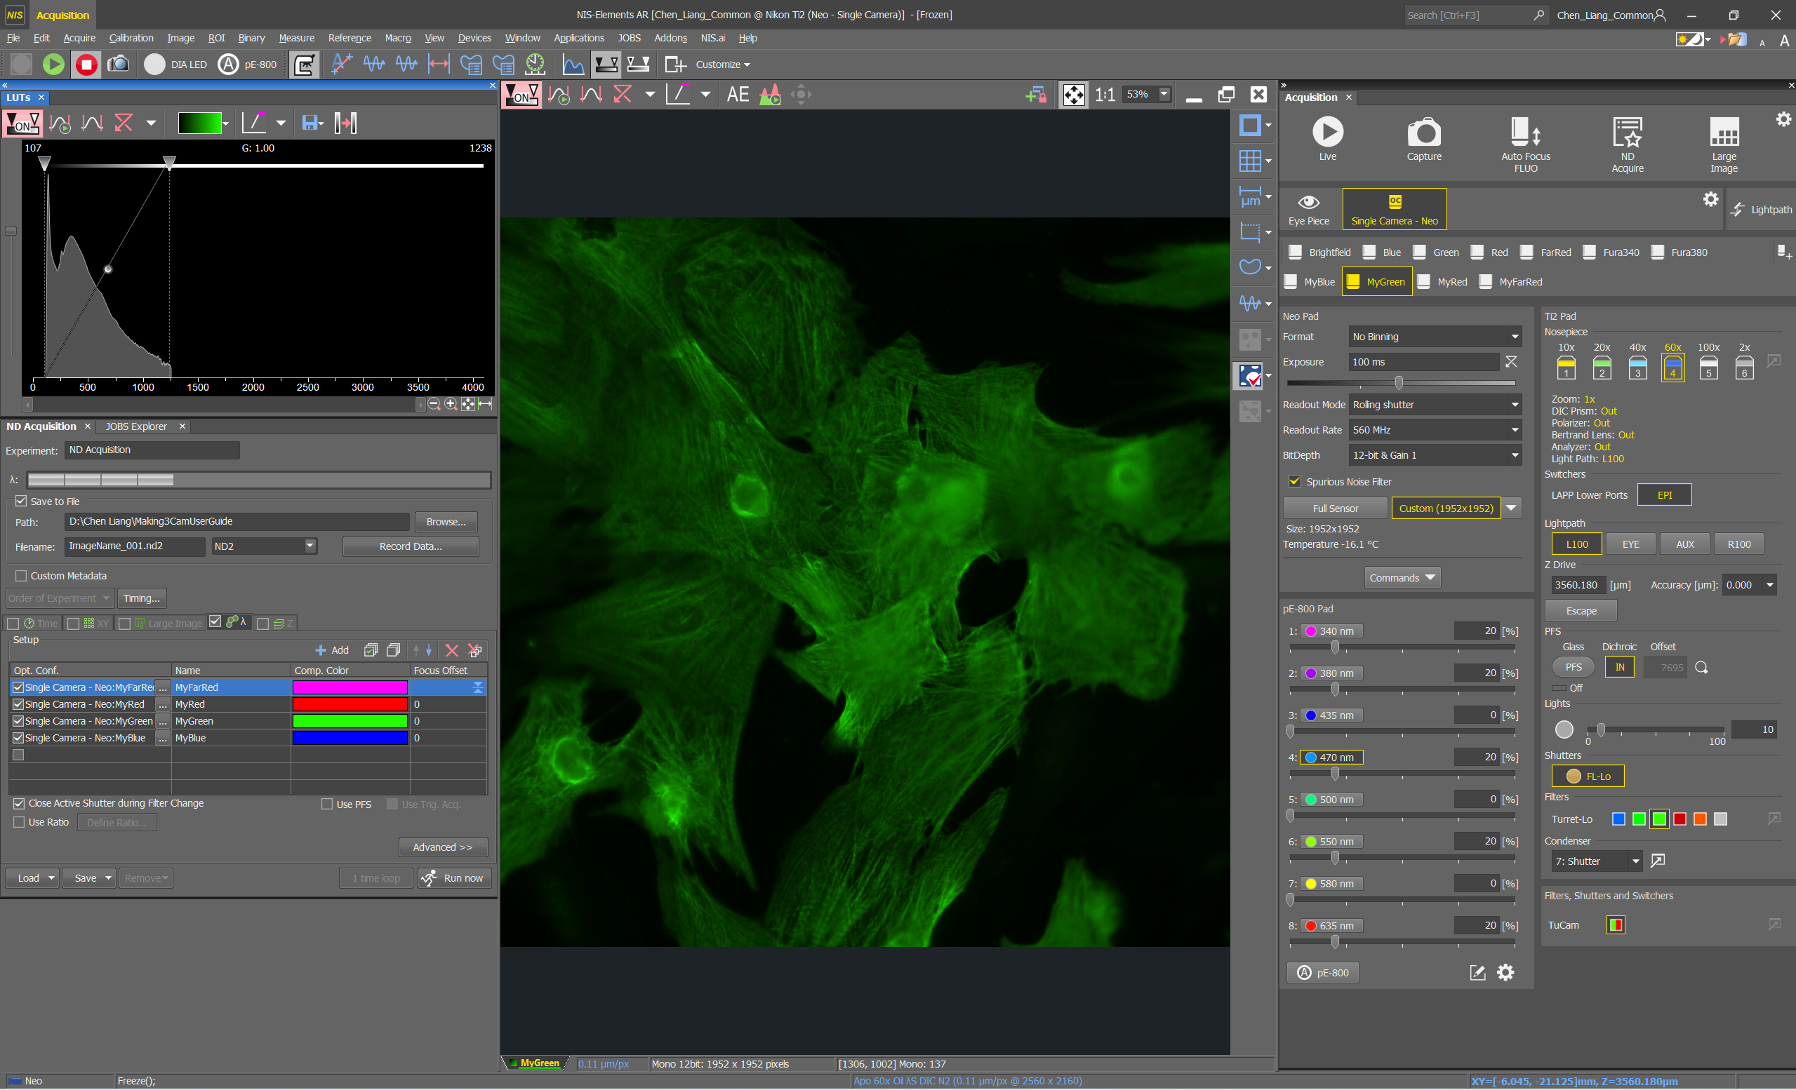
Once you are in focus, move the joystick to place something you want to image right in the middle of your field of view, now switch from eyepiece view to camera view.
Camera view.
Choose a “MyChannel” button with staining in, preferably the channel you saw down the eyepiece.

Slide 7
Adjust to initial settings before trying to see your sample on screen.
Exposure on 100ms
Gain on 12-bit Gain 1
The channel button you are on ( e.g. MyGreen ) will automatically select the correct wavelength (e.g.470nm), please do not change this.
Fluorescent power 20%

Slide 8
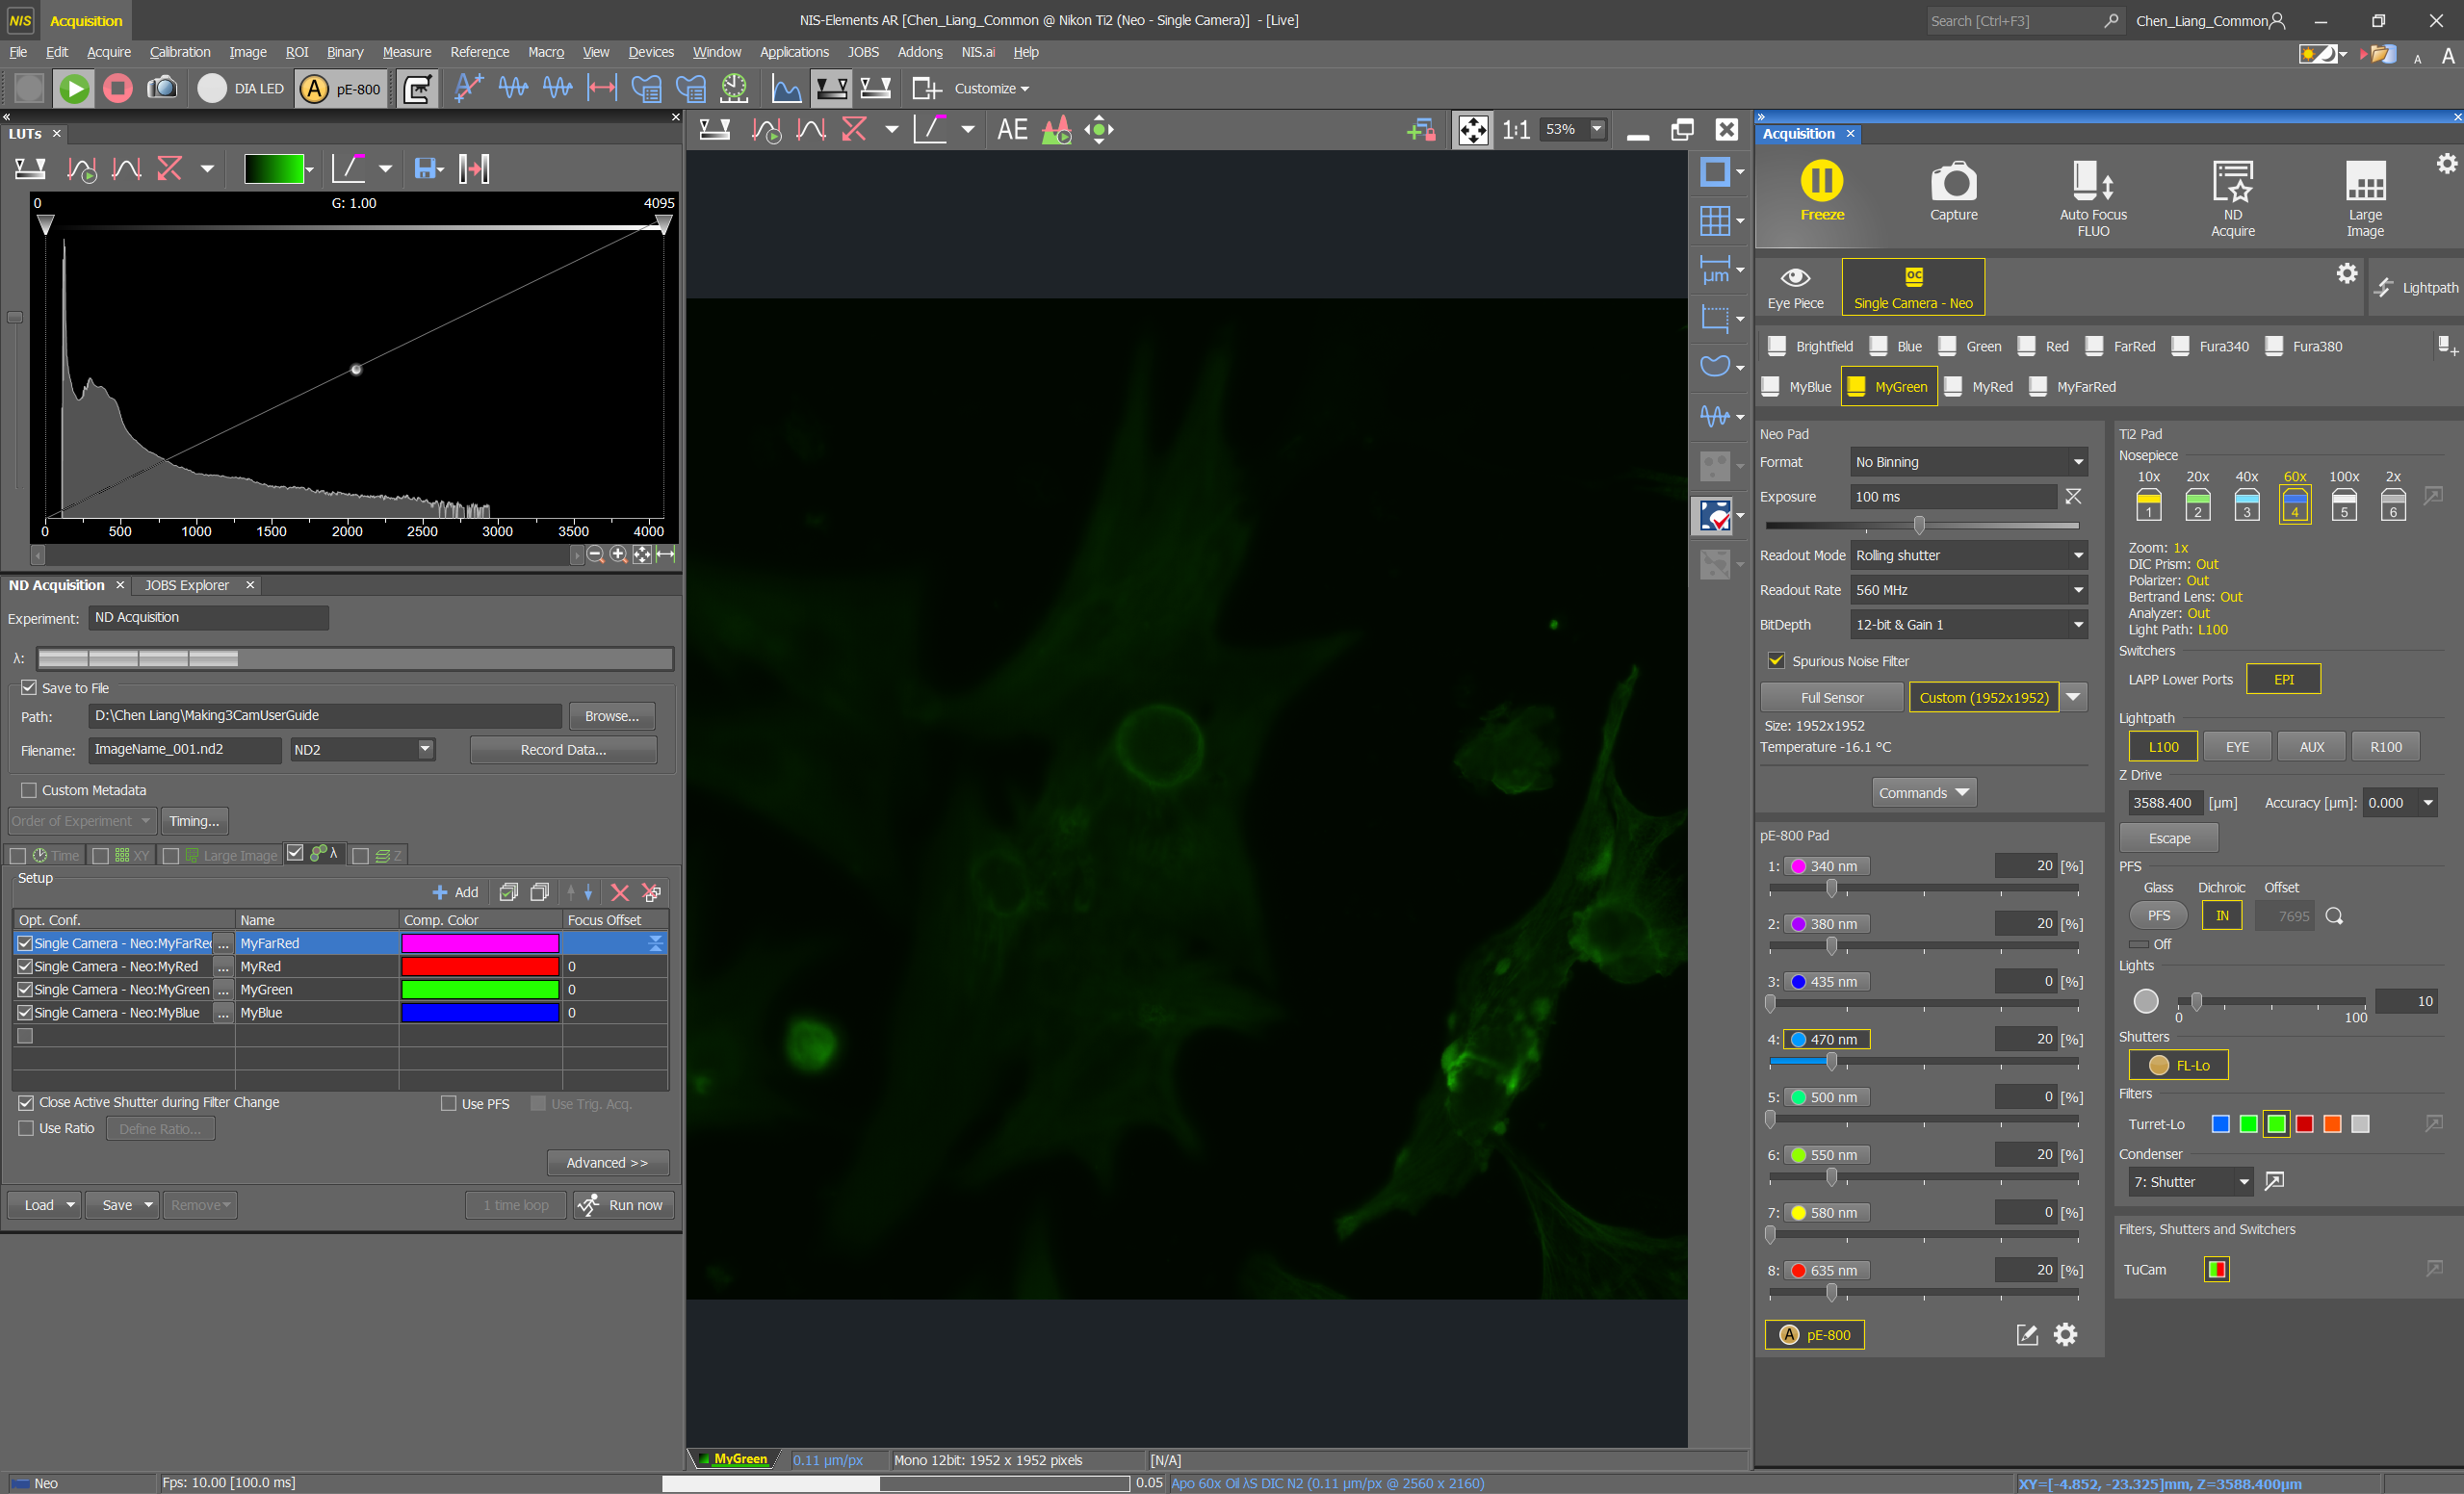
Click on LIVE
Then click on the “4 arrows” button to see the entire field of view.

Slide 9
If you can’t see your sample or it’s very dim, there are 3 things you need to change, to see your sample clearly.
Adjust your LUTs
Focus on camera
Optimise exposure times and fluorescent powers

Slide 10
If you can’t see your sample or it’s very dim, there are 3 things you need to change, to see your sample clearly.
Adjust your LUTs
Focus on camera
Optimise exposure times and fluorescent powers

Slide 11
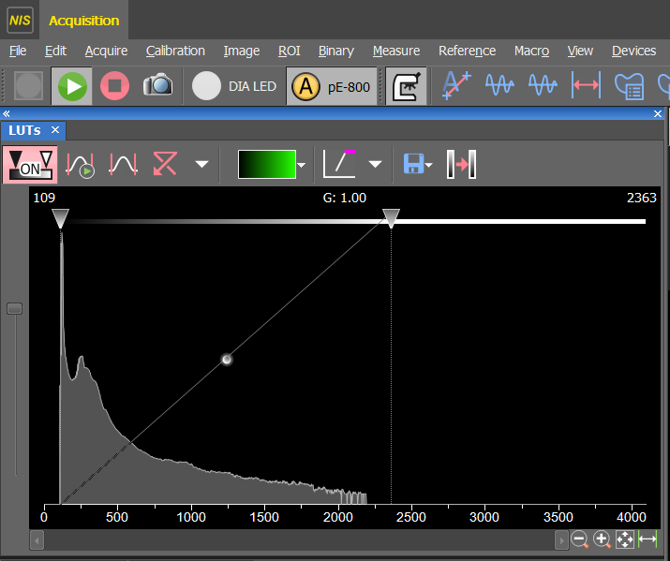
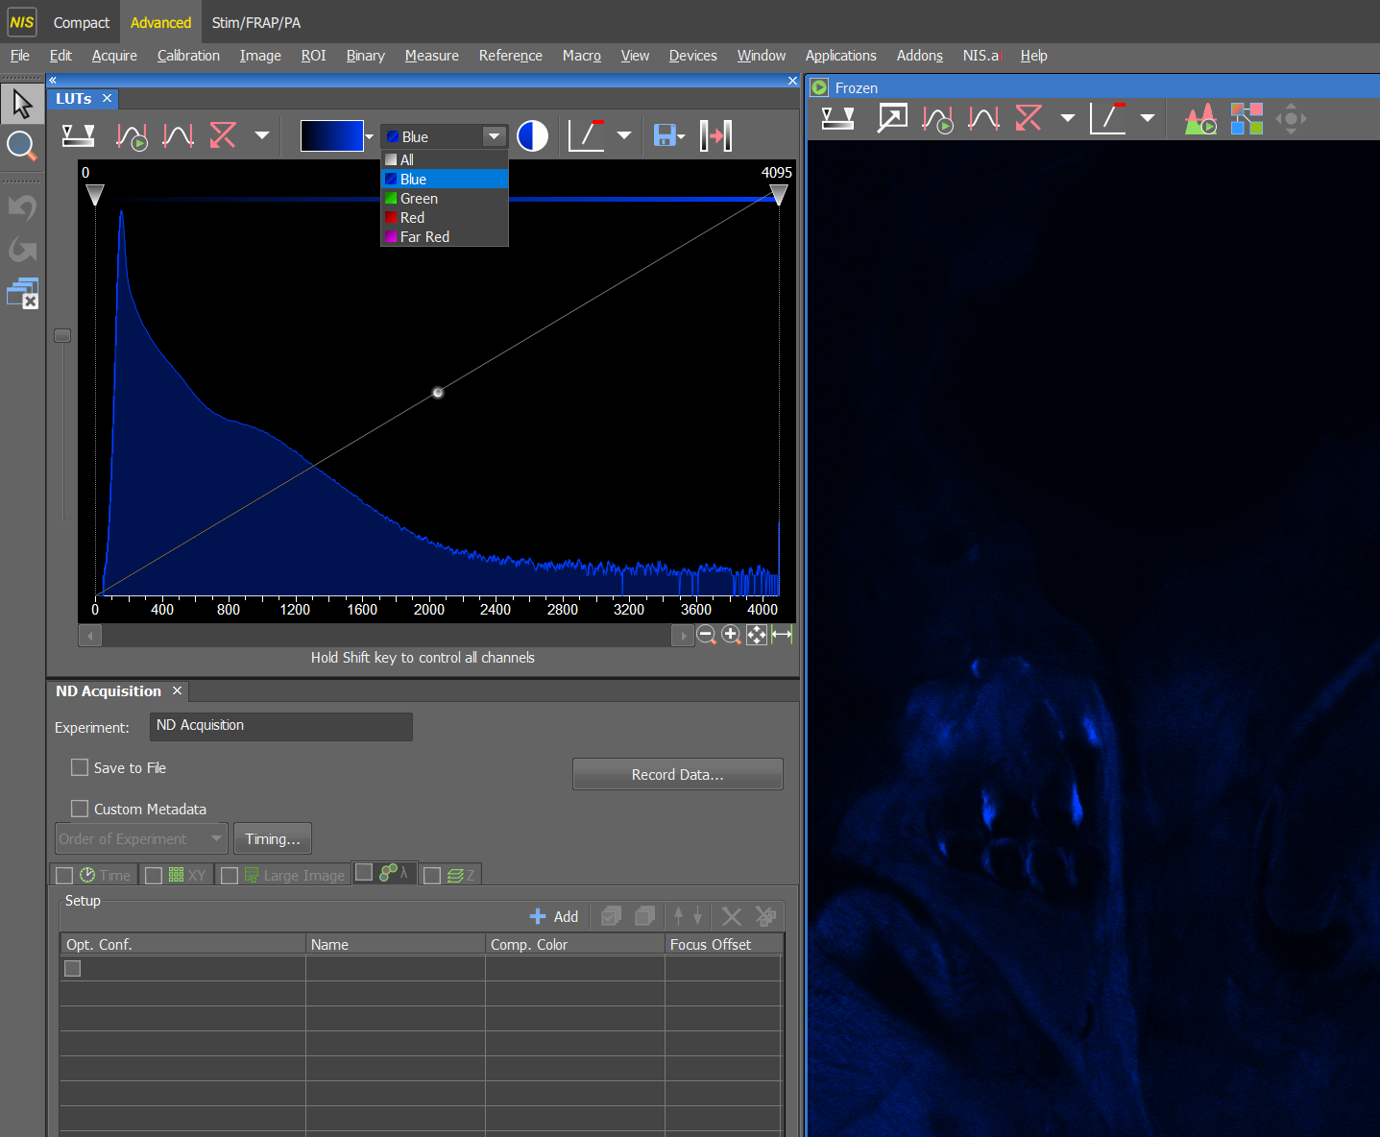
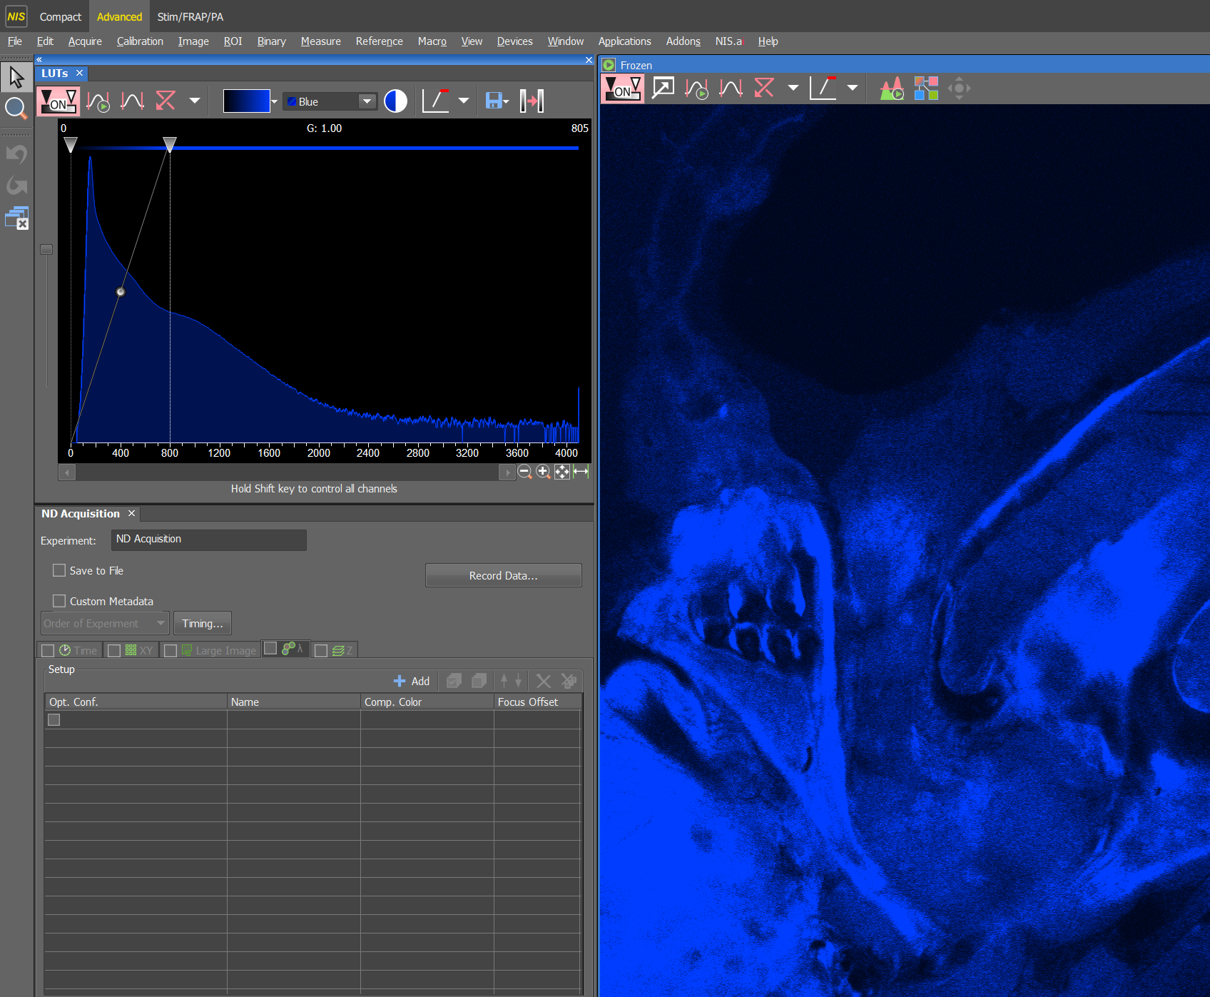
Adjust your LUTs here, using the auto scale button, or click and drag this contrast line down to where your signal graph is.
Make sure this little grey button is always at the TOP, it drops down randomly sometimes during sessions!!!
Make sure you can see the entire graph, click here to zoom out.
Further information about LUT.
Drag the contrast line towards the left if you need to visualise your sample better. Changing the LUT contrast DOES NOT change the raw signal intensity in any way, the sample will look a lot brighter on screen, but your signal intensity, which is what your automated analysis relies upon, remains exactly the same.

Slide 12
If you can’t see your sample or it’s very dim, there are 3 things you need to change, to see your sample clearly.
Adjust your LUTs
Focus on camera
Optimise exposure times and fluorescent powers

Slide 13

Focus on your sample using your mouse wheel.
Focus down the eyepiece will often be slightly different to focus on camera, so now click on ‘LIVE’, then click and hover over the live screen, then use your mouse wheel to focus on your sample. It shouldn’t be too far off, so move your mouse wheel slowly, turning the mouse wheel away from you will lower the lens down, towards you will move the lens up towards the coverslip. If you tried to focus and cannot see anything, please do not keep turning the mouse wheel, just let us know and we’ll help. As your sample comes into focus, you’ll often see your signal intensity increase, keep going until it decreases again, then go back to the peek of focus, where your sample should be the brightest, stop once you’re happy with your focus…
click on ‘FREEZE’ to stop laser scanning.

Slide 14
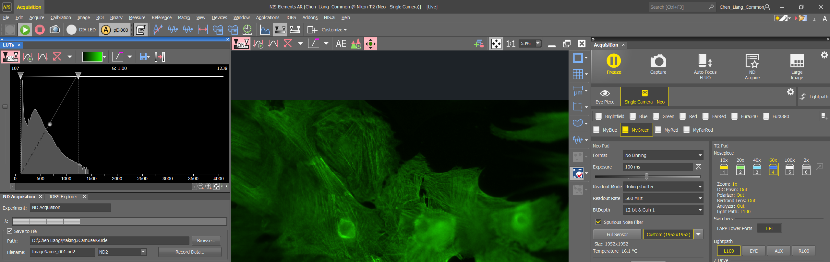
Once you are in focus, you can move the LIVE image by clicking on this button and then click and drag the LIVE image.
Make sure you are zoomed out and can see the entire field of view.

Slide 15
If you can’t see your sample or it’s very dim, there are 3 things you need to change, to see your sample clearly.
Adjust your LUTs
Focus on camera
Optimise exposure times and fluorescent powers

Slide 16
I’m going to use the green channel to demonstrate how to check if you have enough signal intensity for analysis and how to optimise the setup if you don’t have enough or have too much signal.
The LUT may make your image look bright, but your signal intensity might be very weak, you MUST measure the signal intensity to know for sure.

Slide 17
Hover your mouse over your background and read the signal intensity number here (137). Repeat in a few places to work out a rough average background.

Slide 18

Now hover your mouse over a few focused targets you’d like to analyse, work out a rough average signal intensity (883) for your targets. It is important to measure the correct intensity, so if you need to zoom in to be more accurate, you can use this or if you are not on LIVE, then you can use your mouse wheel as a zoom instead of focus.
Now work out the rough difference between your target and background (900 – 150 = 750). Target signal intensity is 750 above background, if you want to do any automated analysis, this difference needs to be 1000 minimum.

Slide 19
If you don’t have a minimum of 1000 intensity signal difference between your target and background, then you need to increase your signal intensity.

Slide 20
STEP BY STEP INSTRUCTIONS
STEP 4
Increasing Signal Intensity

Slide 21
Check your signal intensity graph first. If there are more space to fill with signal, then you can increase the fluorescence power, exposure time and gain.
Make sure this is at the top.

Slide 22
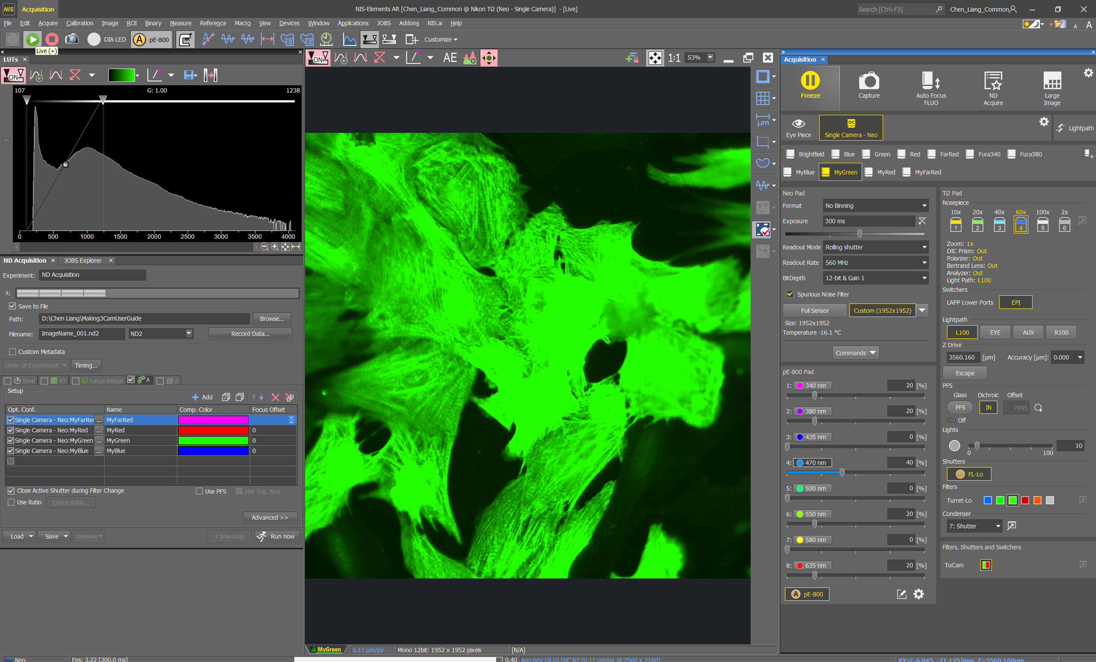
Double check which channel button (Blue, Green, Red, Far Red) you are currently on. It should be highlighted here accordingly, do not change this.
Increase fluorescent power here.
Increase the number slowly, try 10% increments.
High power increases bleaching of your sample.

Slide 23
Increase your exposure time here.
This increases the time the fluorescence stays on your sample. This also cause bleaching, but not as much as increasing power.

Slide 24
Increase your gain here.
Before increasing gain, ALWAYS DECREASE your exposure time and power, e.g. 5ms, and 5% power.
Do this before clicking on LIVE again.
Gain is an amplification of your signal without using more power or exposure time, which is a great tool to increase signal, however, more gain usually means more noise.

Slide 25
After increasing power, exposure time or gain, click on LIVE to rescan.
Your LIVE image and signal graph should update.
If the image on screen looks VERY bright, it doesn’t always mean your signal is too much, look at your graph and where the contrast line is, and auto signal again to readjust your contract.

Slide 26
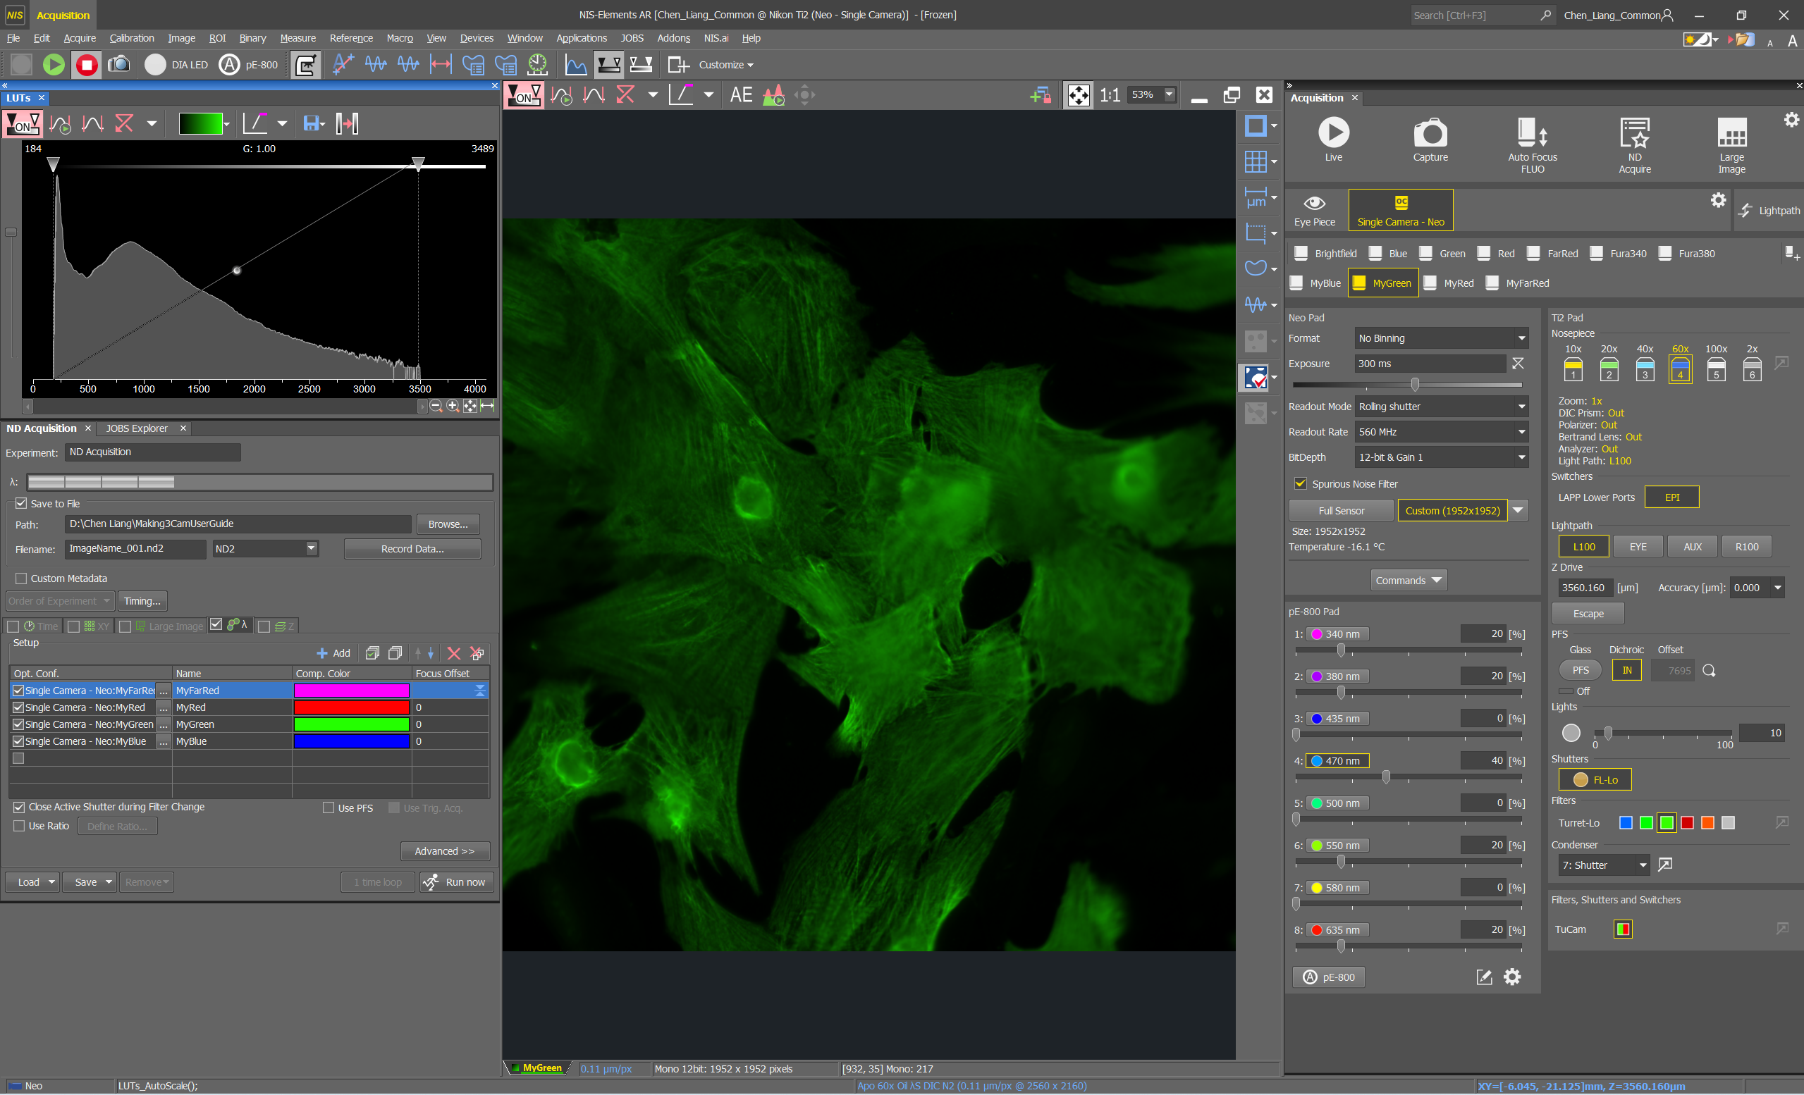
After contrast adjustment, always measure your signal again and calculate if there is a minimum of 1000 signal difference between your target and background.
1000 difference is the minimum, but the bigger the difference, the easier it will be for you to do automated thresholding and analysis thereafter.
Therefore, if you still have some space to increase your signal, please do so.

Slide 27
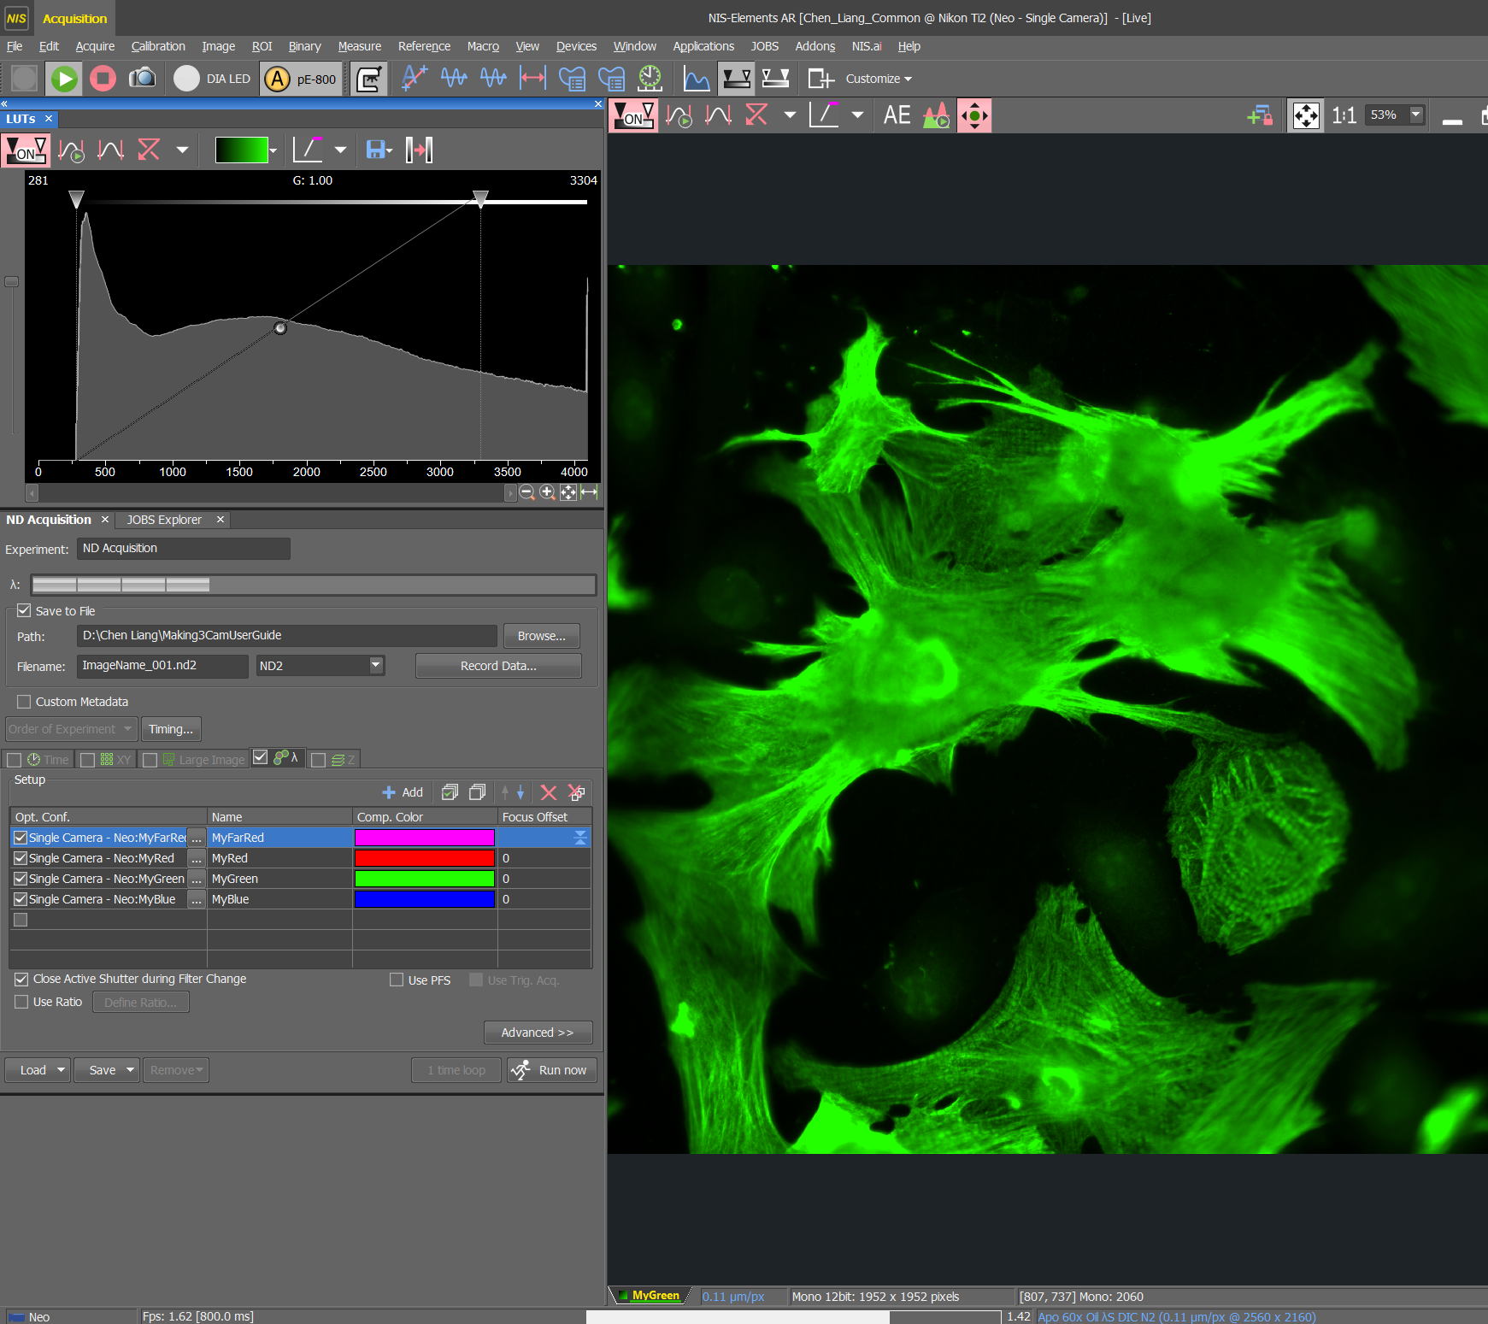
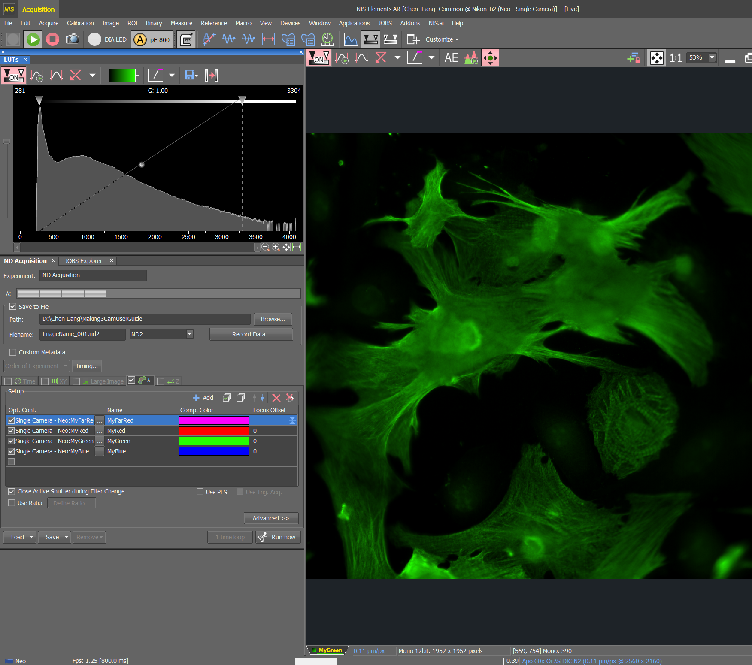
Bleaching in action.
If you stay in LIVE on a single spot for too long, your sample might become bleached, where your signal gets weaker over time, this can be observed in your LUT graph as well as on your live image.
This is not a true representation of your signal and you do not want to optimise your settings on a bleached area of sample, you always want to move to a fresh area of sample to double check your settings.

Slide 28
STEP BY STEP INSTRUCTIONS
STEP 5
Oversaturation

Slide 29
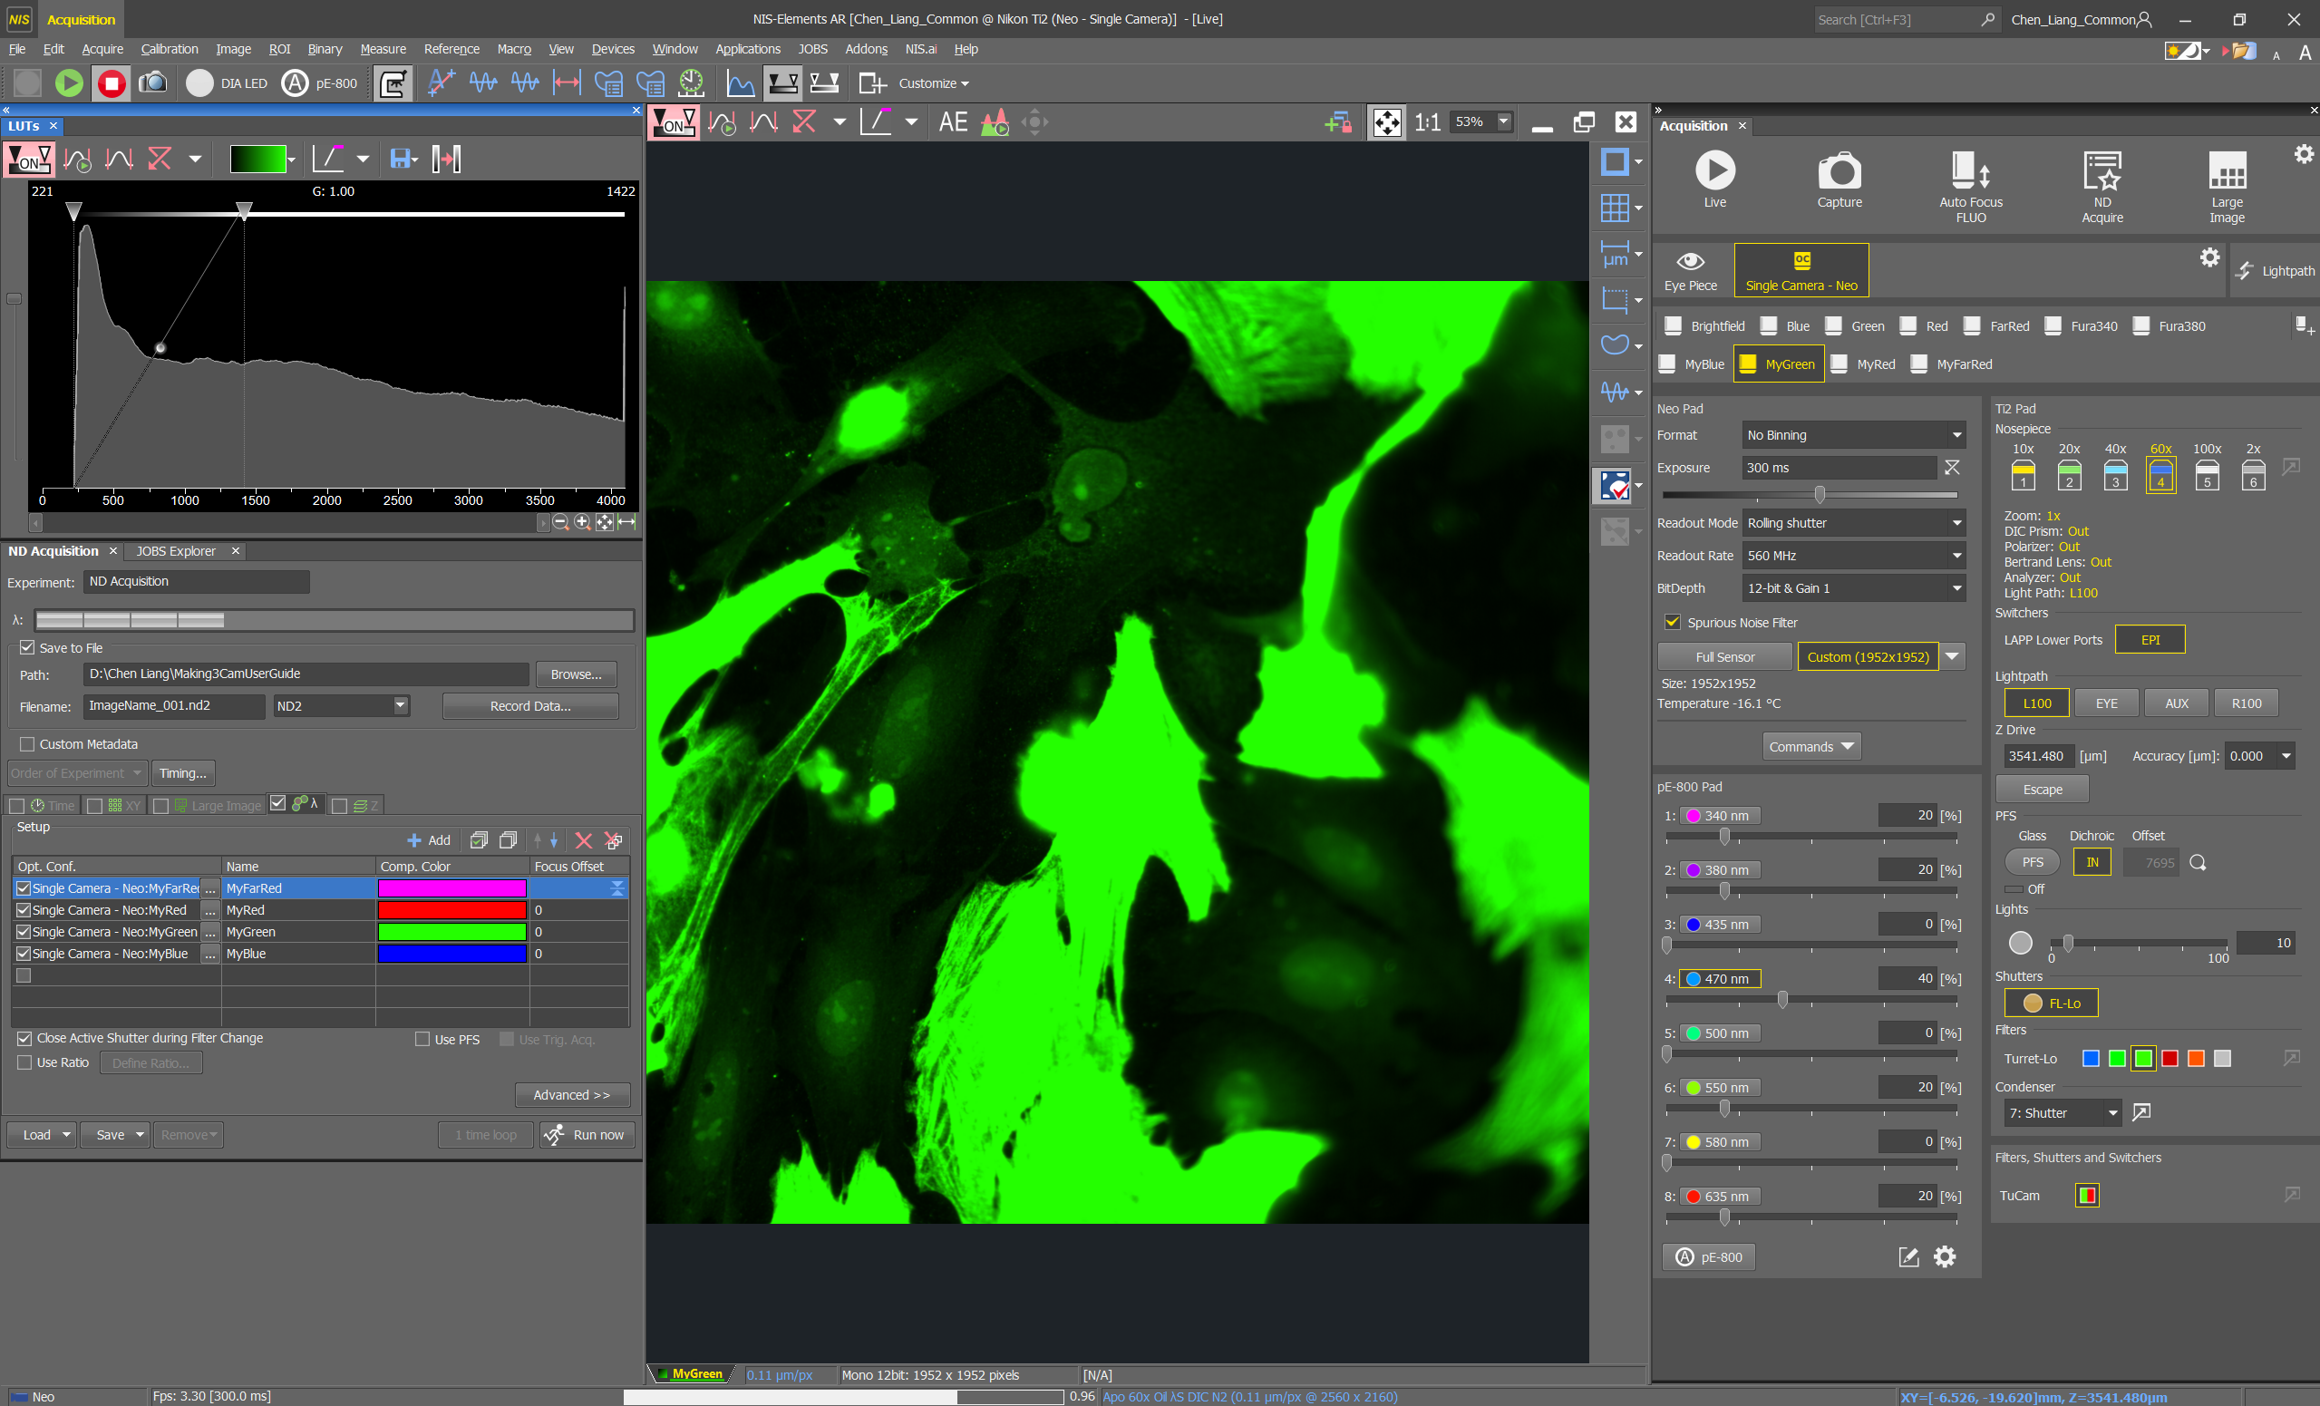
ALWAYS go on live and move to another location and use your mouse wheel to focus again, then check your signal intensity again.
You may have bleached the original area and after increasing the power/time/gain, these new settings might give you TOO MUCH SIGNAL elsewhere.

Slide 30
When your sample emits more signal than the camera can capture, you’ve OVERSATURATED your sample.
An obvious sign of oversaturation is when your signal intensity graph has a peak at the end, but you’ll need the side bar to be at the top for this to show.

Slide 31
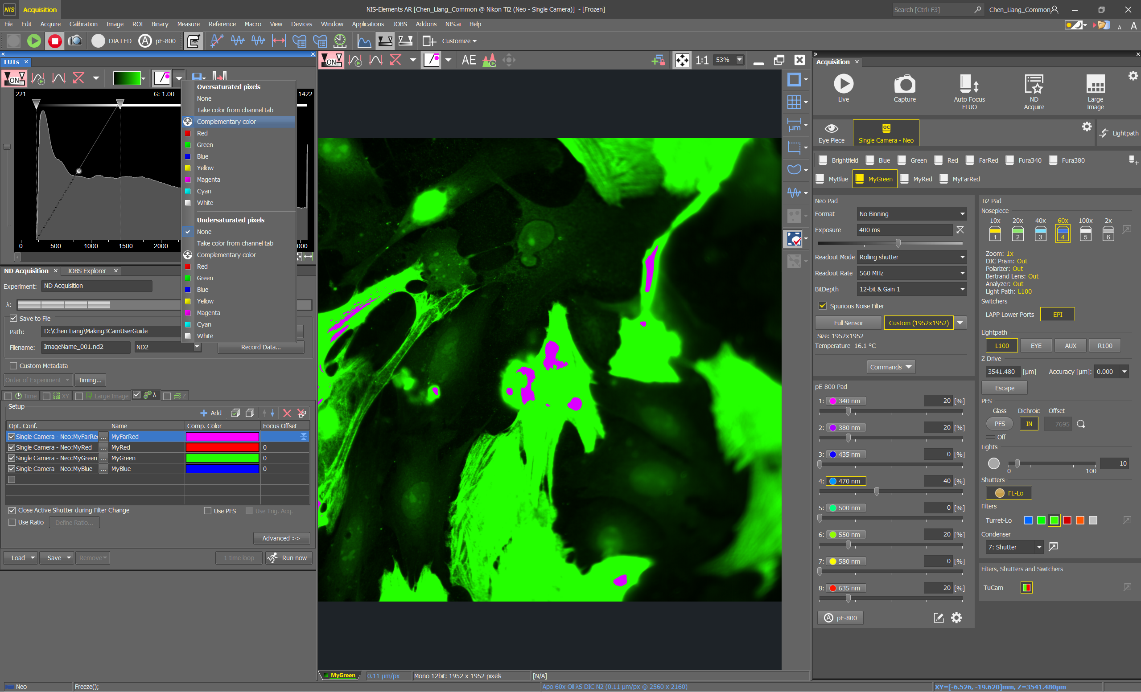
Another way to check oversaturation is using the saturation indicator, you need to go to the drop - down list and select ‘Complimentary colour’ under ‘Oversaturated pixels and areas of oversaturation will be highlighted.

Slide 32

But be careful the oversaturation indicator doesn’t stay on when you go back to live again.

Slide 33
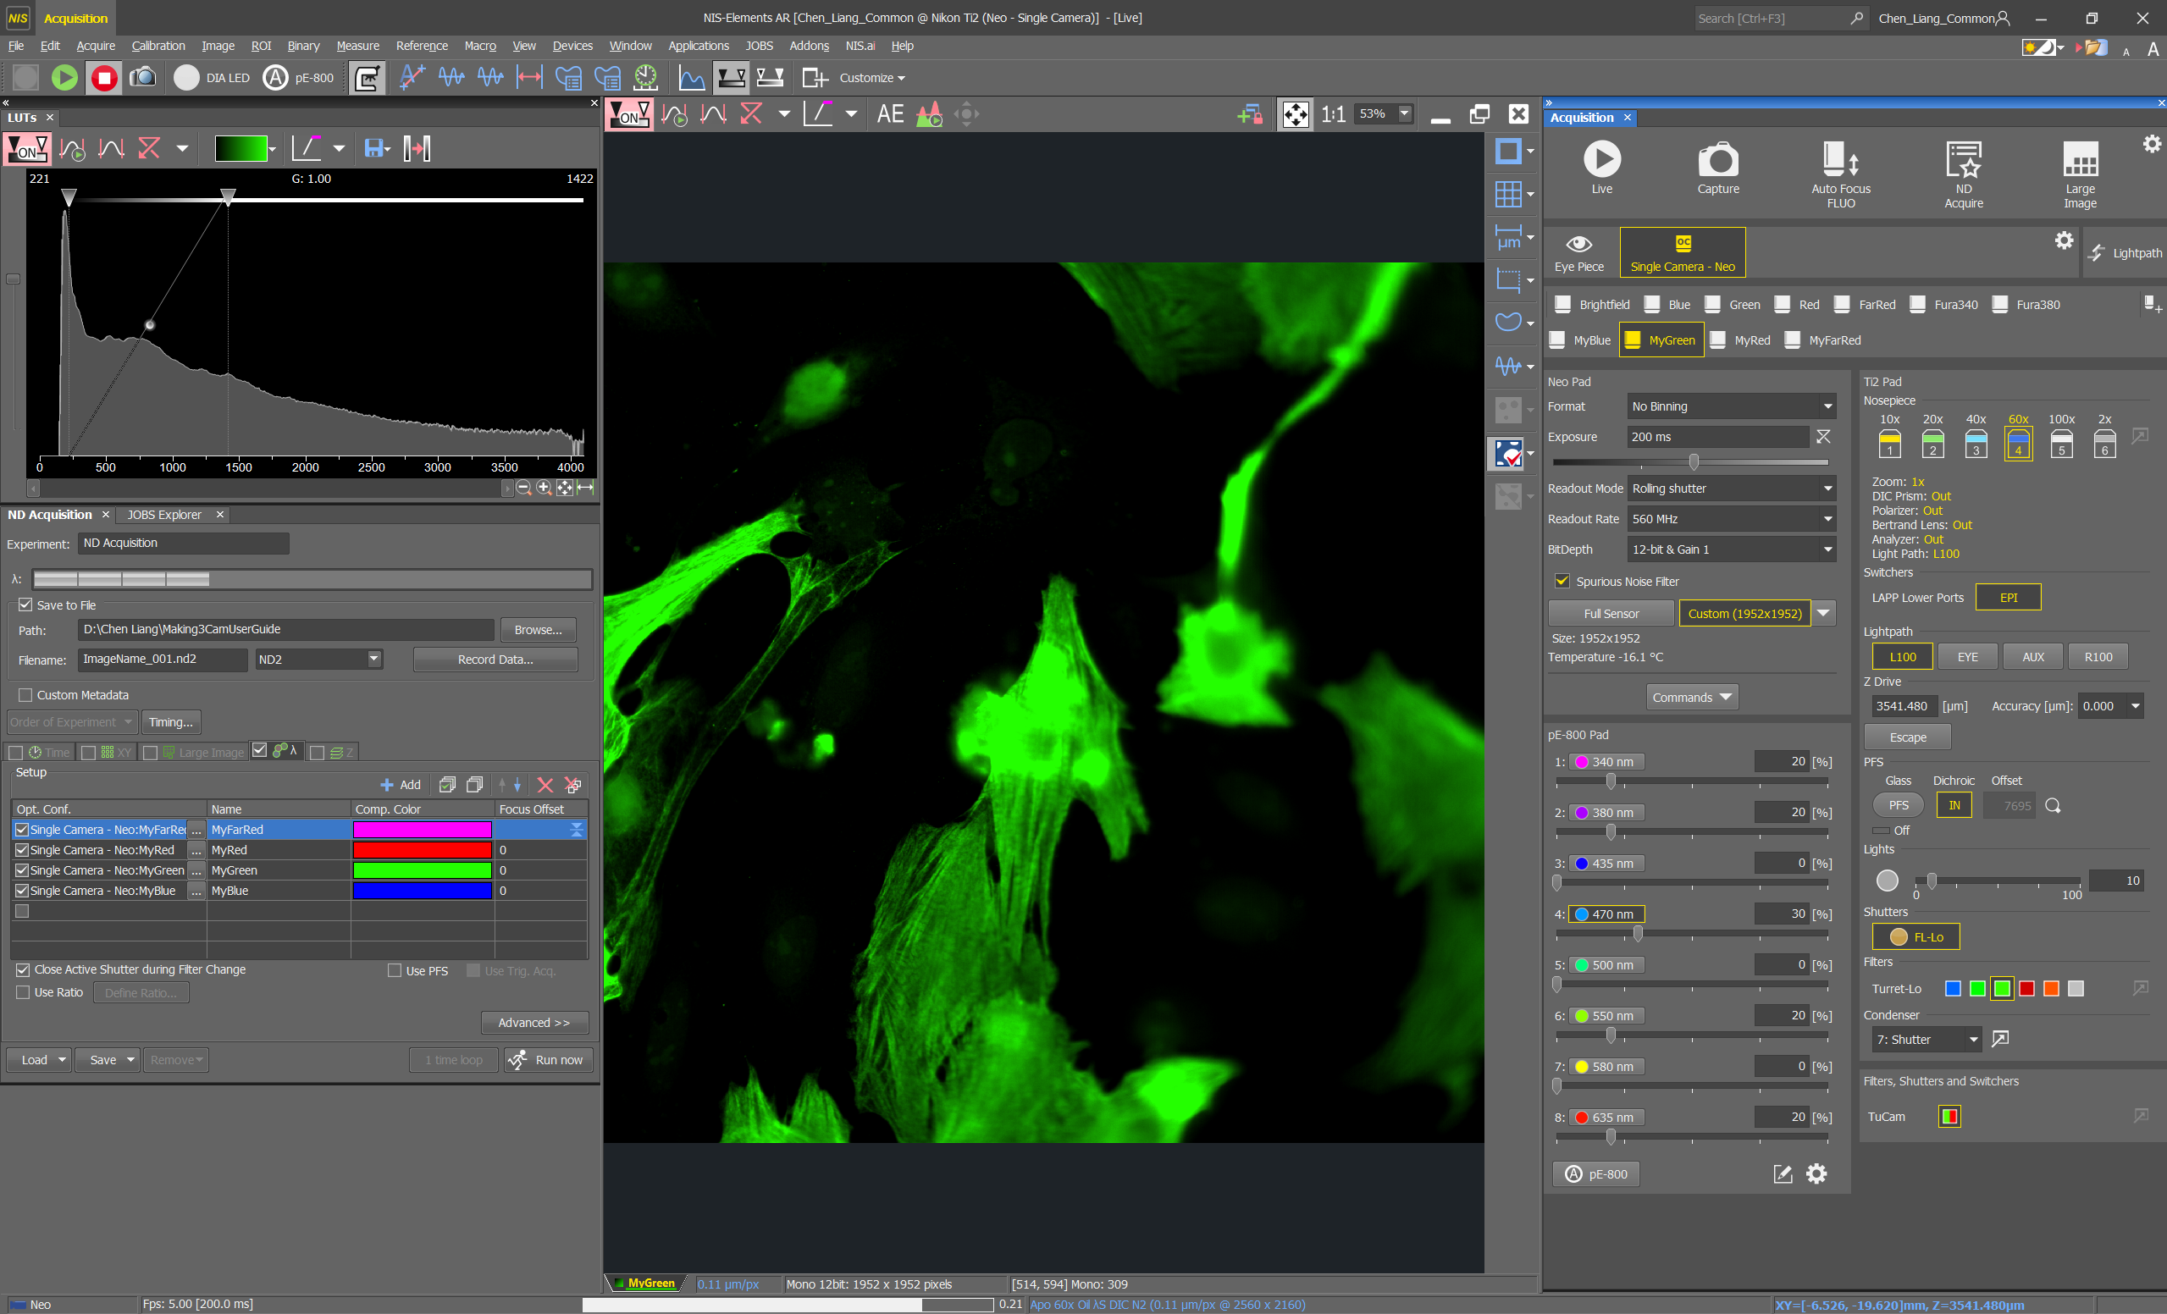
DECREASE the fluorescent power, exposure time and gain to avoid oversaturation.

Slide 34
STEP BY STEP INSTRUCTIONS
STEP 6
Save The Optimised Settings

Slide 35
Certain changes are saved automatically, but if there is a red “ ! ” next to the channel button after you made the changes, it is suggesting you save those changes into the button. Right click on the button and assign camera or device settings or assign all.
Please save the changes before clicking on another button, otherwise your changes will be lost.
Repeat the channels optimisation process for all the channels you want to image.

Slide 36
STEP BY STEP INSTRUCTIONS
STEP 7
Taking An Image

Slide 37
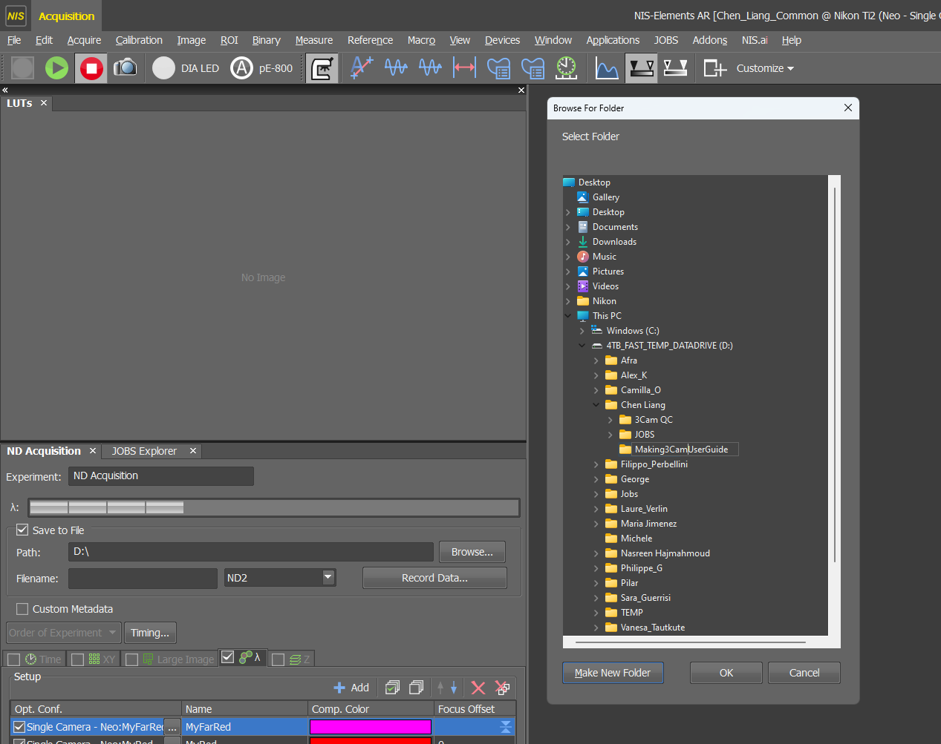
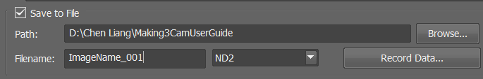
Set up SAVE TO FILE before imaging.
This is ND acquisition.
The first thing you want to set up is “save to file”, once this is set up, all the images you rake using the ND acquisition tab, will be automatically saved.
Always make sure the box is ticked, then make a folder on:
This PC 4TB_FAST_TEMP_DATADRIVE
Your folder
Click on Make New Folder
Type in the folder name and click OK.
Then give your next image a name in ‘Filename’, please do not use any symbols, if you need a space use underscore, put _001 at the end so your second image will be _002. You do not need to click on anything else, ‘Save to File’ is now applied.

Slide 38
These are the common applications used to take images.
Single 2D Image
Z – stack 3D Image
Large Image
XY Positions
Timelapse

Slide 39
These are the common applications used to take images, they are found in ND Acquisition
Single 2D Image
Z – stack 3D Image
Large Image
XY Positions
Timelapse

Slide 40
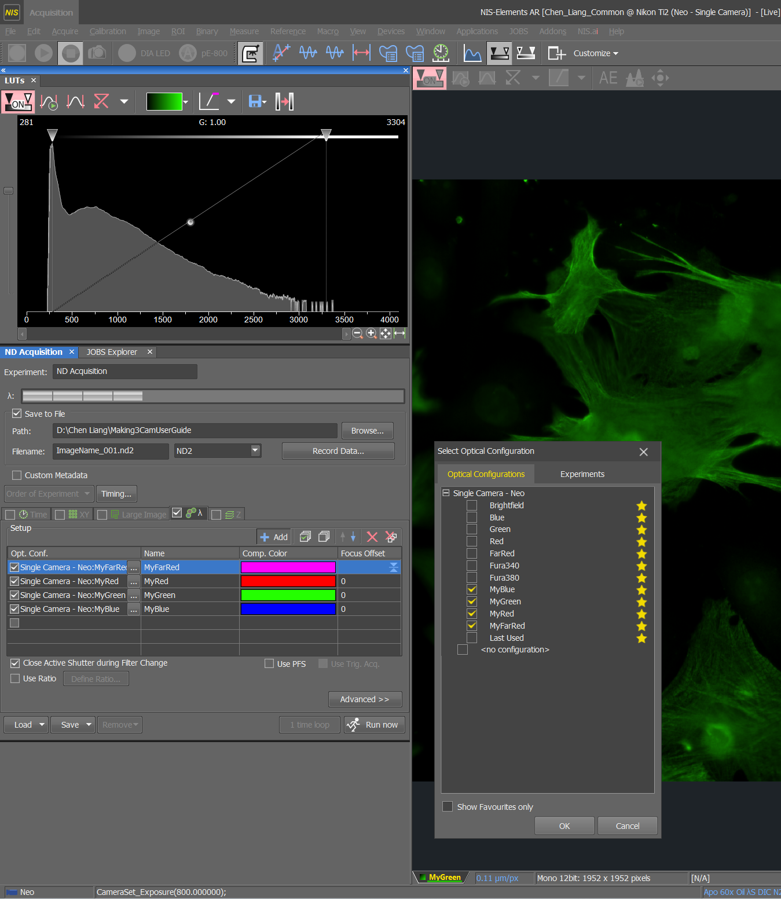
Make sure you are happy with focus and signal on LIVE.
Go to the channels tab and add in all the channels you want to image, make sure to add the correct corresponding Optical Configuration buttons such as MyBlue, MyGreen…
Tick on the channels you want to use.
Tick Close active shutter.
Make sure only the channels tab is ticked.
Click on Run Now

Slide 41
These are the common applications used to take images, they are found in ND Acquisition
Single 2D Image
Z – stack 3D Image
Large Image
XY Positions
Timelapse

Slide 42
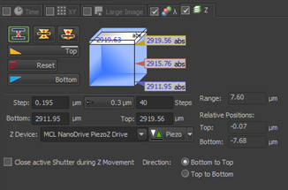
Z stack Basic Options
Asymmetrical: find focal plane and then set different distances above and below. (Useful for like cells)
Set top and bottom: use mouse wheel to focus and define the exact range of your Z stack.
Set Middle: use mouse wheel to find the mid point of your Z focus and set equal distance above and below the focal plane. (Useful if your sample is symmetrical along the Z axis)
Step Size
You can set step size or number of steps.
Use recommended step size to capture all the information.
Fewer steps than the recommended is called under-sampling and you may loose information.
More steps than the recommended is called over-sampling (typed in here) which is required for 3D deconvolution.

Slide 43
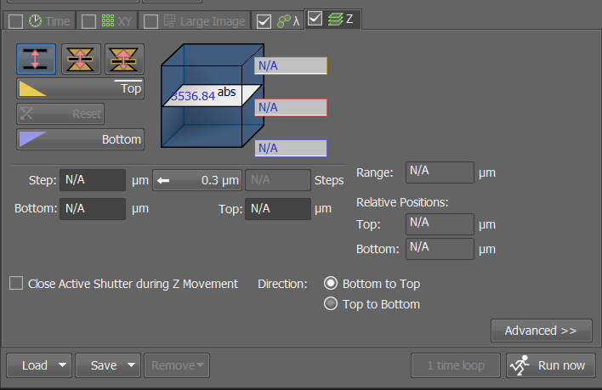
Tick the Z tab in addition to the channels tab.
Choose your method, I’ll use the first one for this guide.
Press reset.
Go on LIVE and click and hover your mouse on your live window and scroll your mouse wheel towards you (lens going up) until the top of where you want to image and click on ‘Top’.
Hover your mouse over your LIVE window again and scroll your mouse wheel away from you (lens going down) and scroll through your sample and click ‘Bottom’.

Slide 44
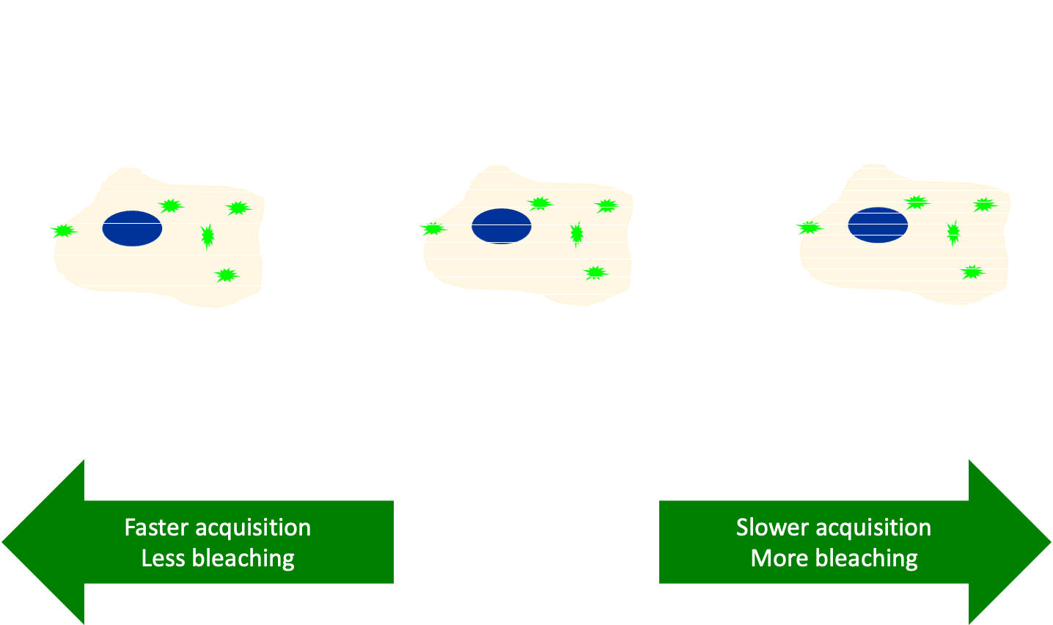
Click on FREEZE to stop scanning.
Click on the recommended step size, this will give you the optimum image resolution in the Z range.
You have the option to manually change the step size by typing here. Longer distance (Under-sampling) between each step will result in fewer steps in total, fewer steps takes less time to image but you may miss out on information. Shorter distance (Oversampling) between each step will result in more steps in total, this will take longer to image, but you can use these extra information in 3D deconvolution on the workstations after imaging to increase your image resolution even further.
Click on ‘Run Now’ to take your Z-stack image.

Slide 45
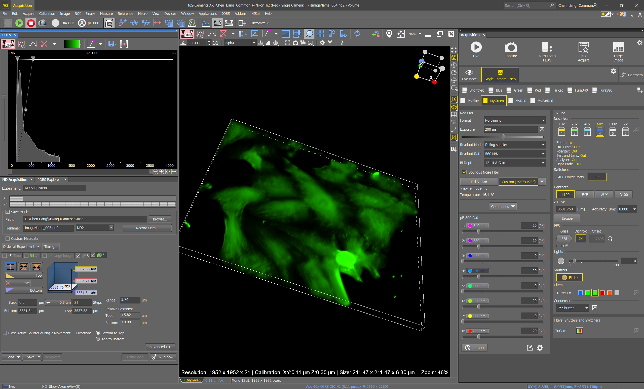
There are many methods to view a Z– stack image, this is the 3D view.
Please look through these options to the find the most suitable for you, you can do this on the workstations.

Slide 46
These are the common applications used to take images, they are found in ND Acquisition
Single 2D Image
Z – stack 3D Image
Large Image
XY Positions
Timelapse

Slide 47
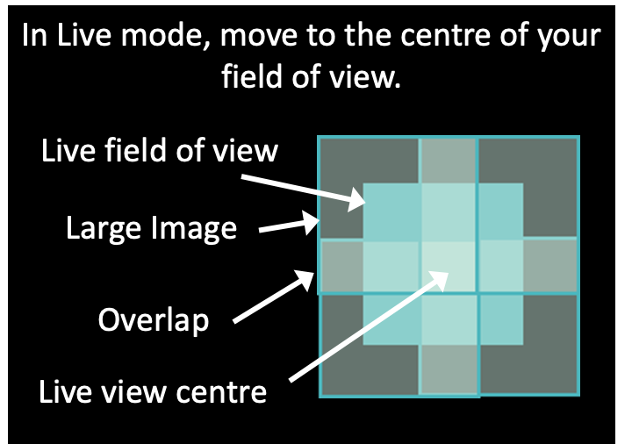
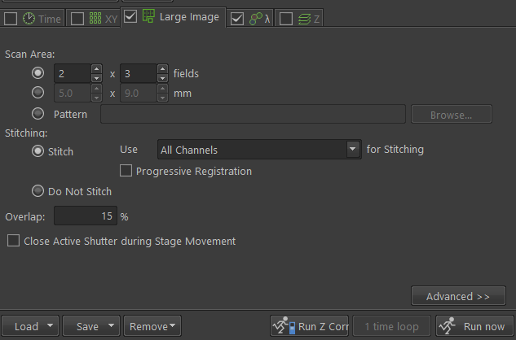
Click on LIVE and focus on your sample (especially after doing a Z-stack), your live view will be the centre of your large image, this is a diagram of a 2 by 2 large image.
Tick on ‘Large Image’ and ‘Channels’ tabs, make sure the Large Image tab is on the left hand side of the Channels tab, you and click and drag these tabs to re-order them.

Slide 48
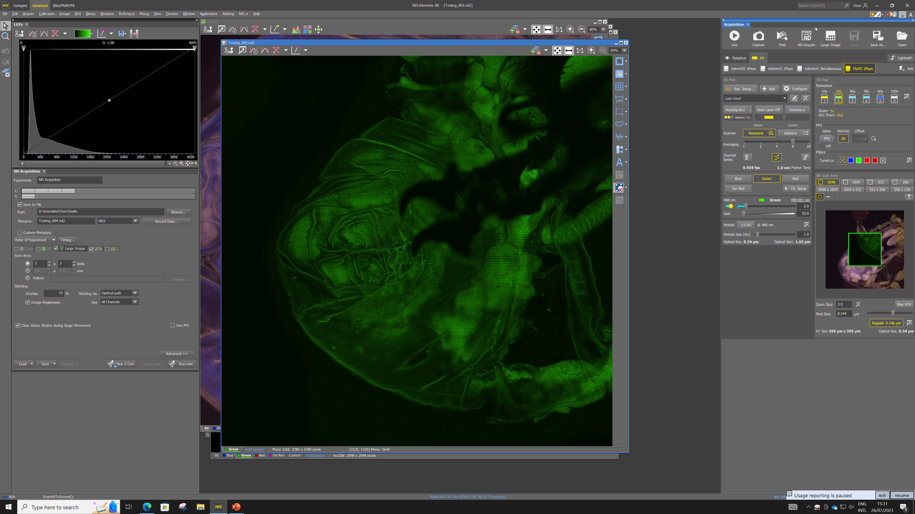
Enter in the Scan Area, how many fields of view you need in the X and Y axes, respectively.
Be mindful where you are on your coverslip, make sure you’re not at the edge.
If you want to stitch up your large image, you need 15% overlap minimum.
Click on ‘Run Now’ to take your Large Image.

Slide 49
Click on this to see your entire stitched up image.
Make sure to check the stitching for errors such as misalignment and doubling.

Slide 50
These are the common applications used to take images, they are found in ND Acquisition
Single 2D Image
Z – stack 3D Image
Large Image
XY Positions
Timelapse

Slide 51
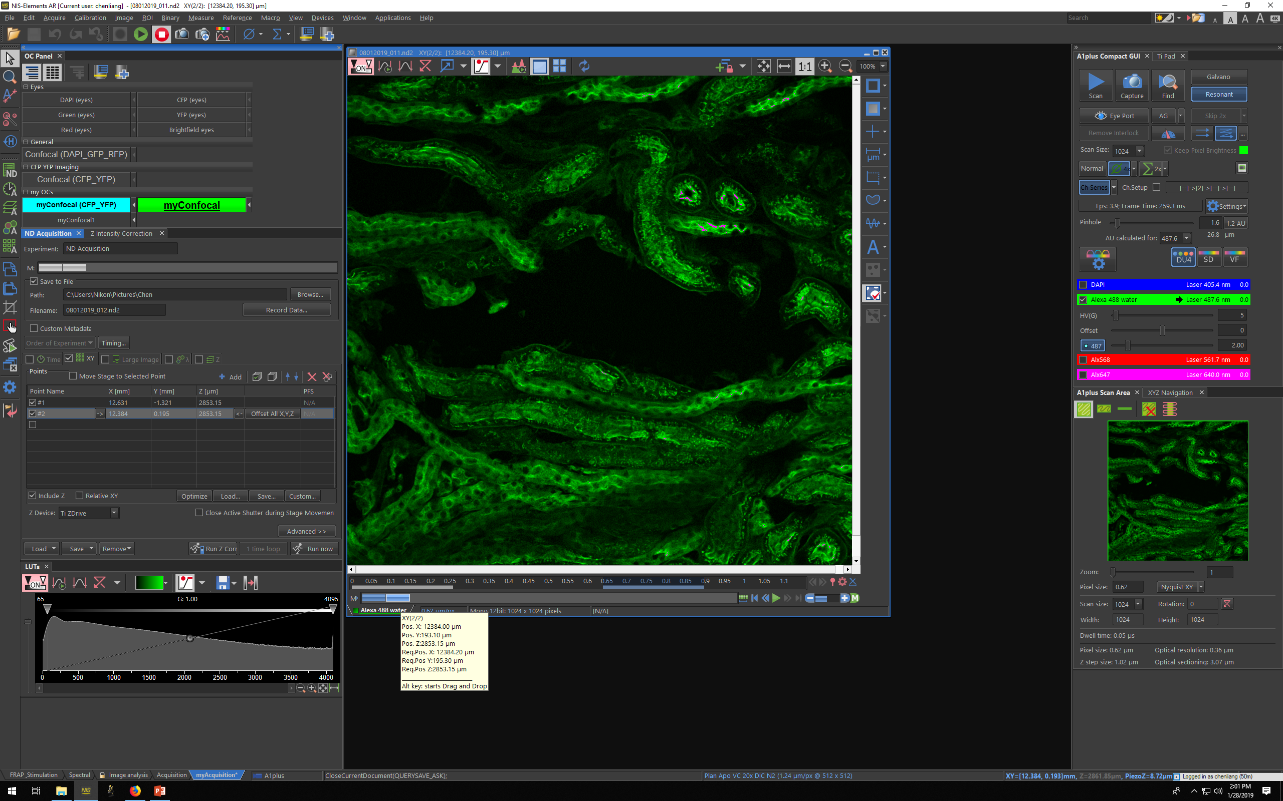
Tick on the XY tab and click on ‘Include Z’, also tick on the channels tab.
Click on LIVE and focus on your sample, move to a field of view you want to image. Click ‘Add’ to set this XY position.
Move to another field of view, be mindful where you are on your coverslip, focus again if you need to and add this position.
Repeat for as many positions as you require on the same coverslip and press ‘Run Now’ to take images at multiple XY positions.

Slide 52
ALWAYS REMOVE ALL POSITIONS AS SOON AS YOU’RE DONE IMAGING THEM.

Slide 53
These are the common applications used to take images, they are found in ND Acquisition
Single 2D Image
Z – stack 3D Image
Large Image
XY Positions
Timelapse

Slide 54
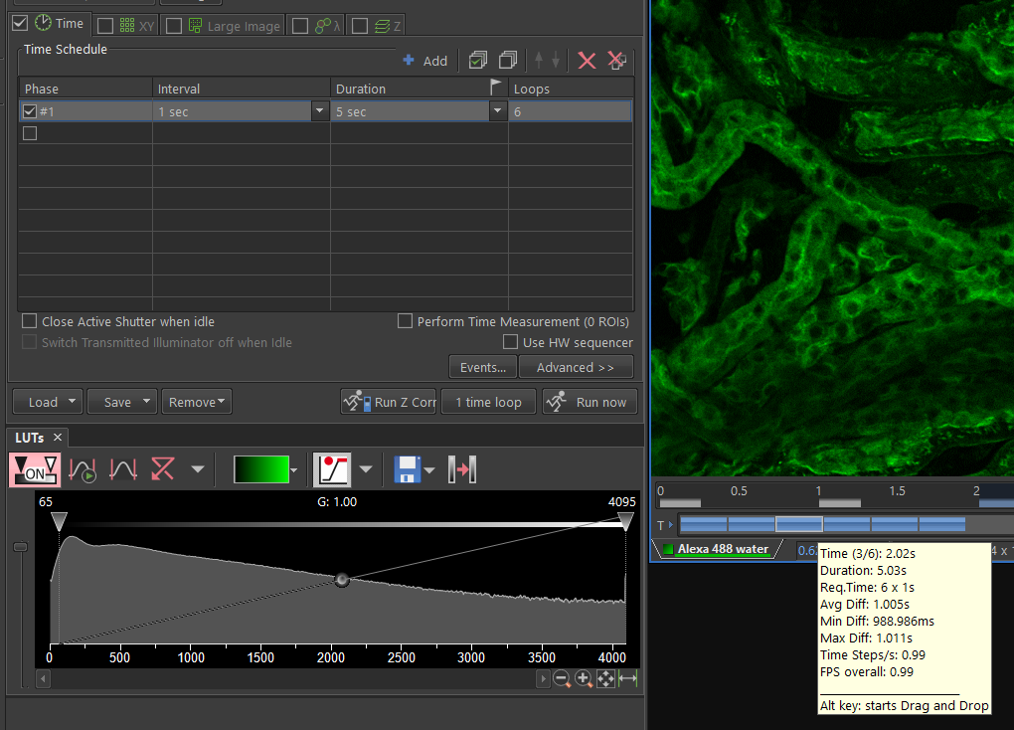
Tick on the Time tab and add a time-lapse, also tick on the channels tab.
Interval (how long between each scan)
Duration (how long the overall time-lapse)
Loops (how many images will be taken)
Click on LIVE and focus on your sample, move to a field of view you want to image and click on ‘Run Now’.
If you’ve not been trained to use Timelapse or set up live imaging, please let us know and we’ll be happy to help.

Slide 55
STEP BY STEP INSTRUCTIONS
STEP 8
At The End Of Your Session

Slide 56
At the end of your session, stop scanning, click on ‘Eyepiece’.
LOWER THE LENS to the very bottom!!!
Remove your sample and the sample holder.
If you’ve only used the dry lens, you do not need to clean anything.
If you used the water or oil lenses, then please clean the lens, once with dry lens tissue to wipe as much oil off as you can, then 3 to 6 times with fresh lens tissues with ethanol, then once more with dry lens tissue.
Always leave the microscope on 20X lens, lowered to the bottom, for the next user.
Please clean up after yourselves. All bins in the WCIC are for PAPER only, if you have any gloves/media/cells/slides/etc. you’d like to throw away, please dispose of it in the wet lab, thank you.

Slide 57
STEP BY STEP INSTRUCTIONS
STEP 9
Close NIS – elements

Slide 58
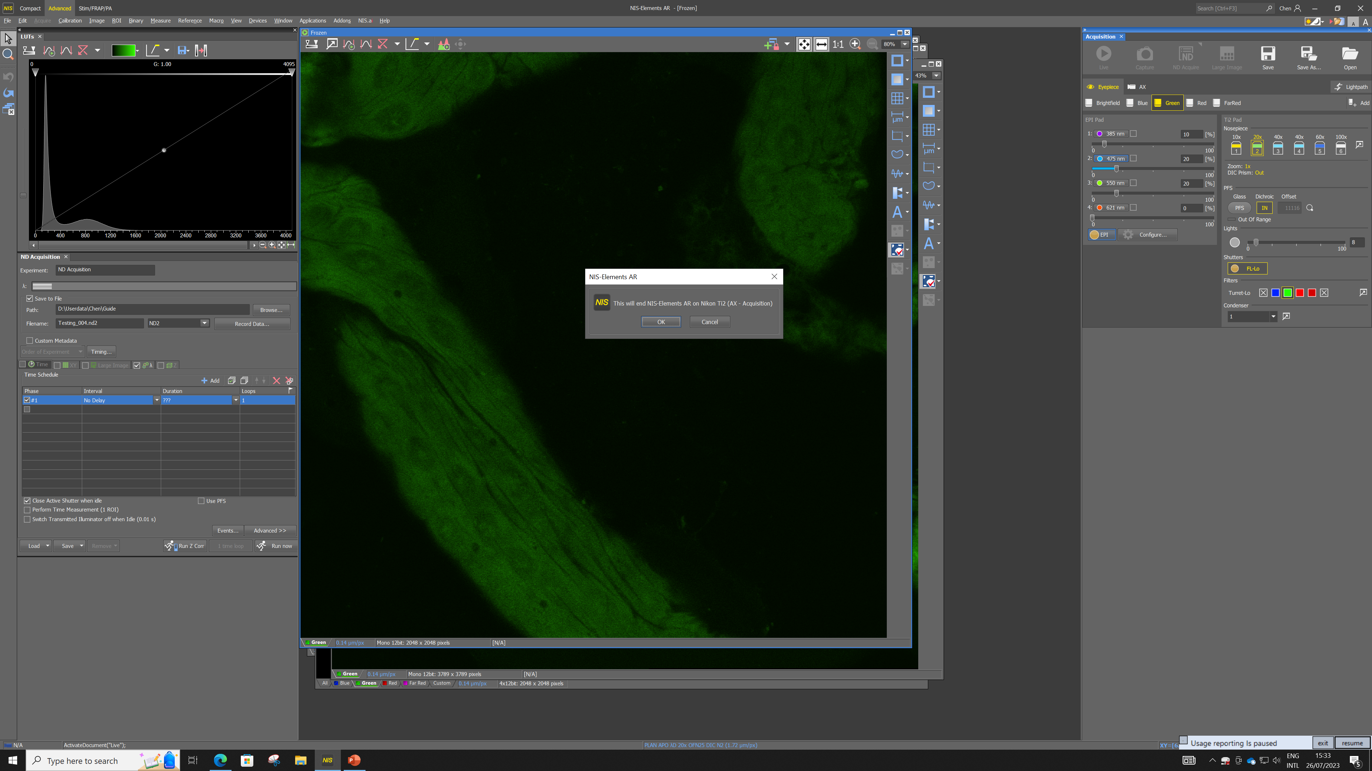
Close the software from here.
Sometimes the software will remind you to save the changes you’ve made to your images, such as if you added a region of interest or a scale bar, etc. ‘SAVE AS’ if you do want to save these changes.
If you have ‘Save To File’ set up correctly, your raw images should already have been saved. You can check them in ‘file explorer’ before closing the software if you’d like.

Slide 59
STEP BY STEP INSTRUCTIONS
STEP 10
Data Transfer

Slide 60
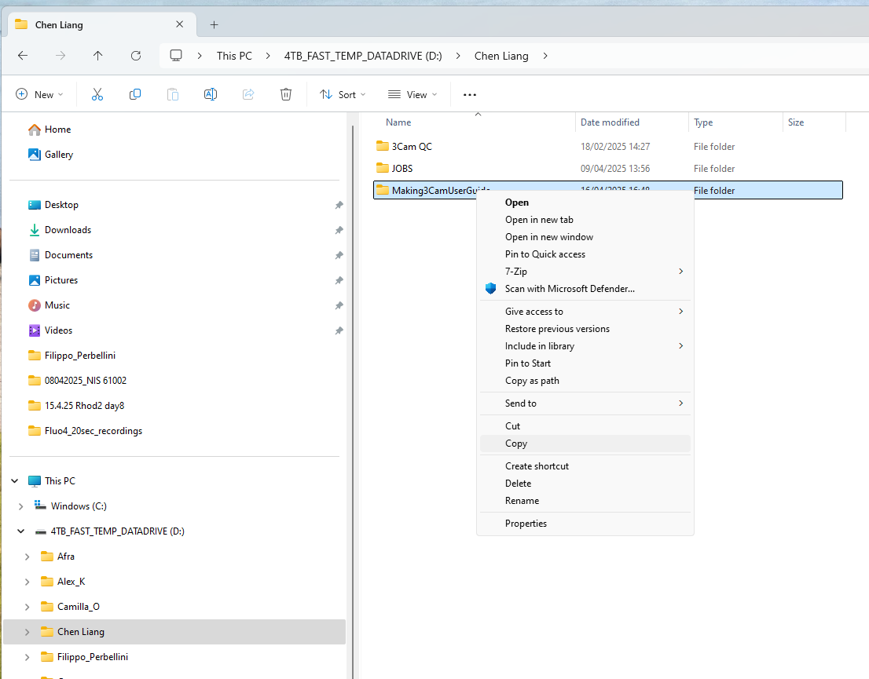
Go to File Explorer.
Find your data where you saved it in ‘Save To File’ and copy.

Slide 61
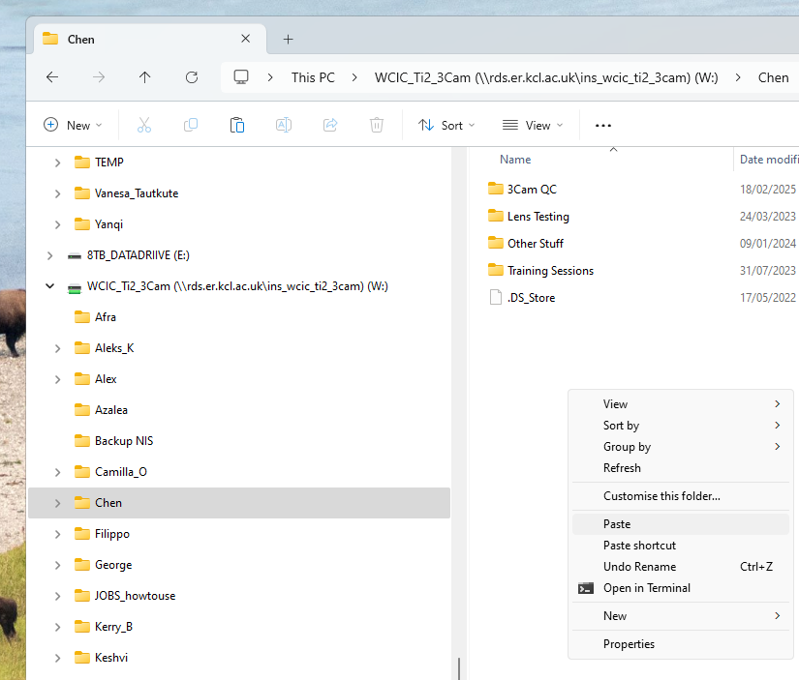
On the left - hand side, click on the WCIC shared drive.
Click on “ WCIC_TI2_3Cam ” RDS folder.
Find your folder
Paste your data.

Slide 62
This shared network is for data transfer only, it is not a backup storage, please connect your own computer to this shared drive (instructions can be found in your PPMS booking system > Documents > Accessing The Network Drive) or book and go to the workstations with an external storage device, and copy and paste your data into your personal backup storage.
DO NOT plug in USB or external storage into the Microscope PCs!!!!

Slide 63
STEP BY STEP INSTRUCTIONS
STEP 11
Check PPMS Booking System

Slide 64
ALWAYS check PPMS booking system at the END of your session, to see if anyone if using it after you.
If another user is booked on within 2 hours, please leave the microscope on, you just need to make sure your NIS-Elements software is closed, your data transferred and finally, sign out of Windows from ‘Start’ (bottom left).
If no one is booked on within 2 hours, please close the NIS-Elements software if you haven’t already, then switch off the system in reverse order. Please watch the 3Cam switch off video here:
Before you leave, please help us keep the room clean, use ethanol to clean up any accidental oil and media spills, the bins in the WCIC are for paper waste ONLY, please take any other rubbish with you (i.e. gloves and sample) and dispose of them in the main wet labs.
Thank you and enjoy imaging.

Slide 65
Happy Imaging

